Slide 1
Variable Fonts TUG 2021
Dave Crossland Lead Program Manager Google Fonts August 6, 2021
Notes:
.

Slide 2
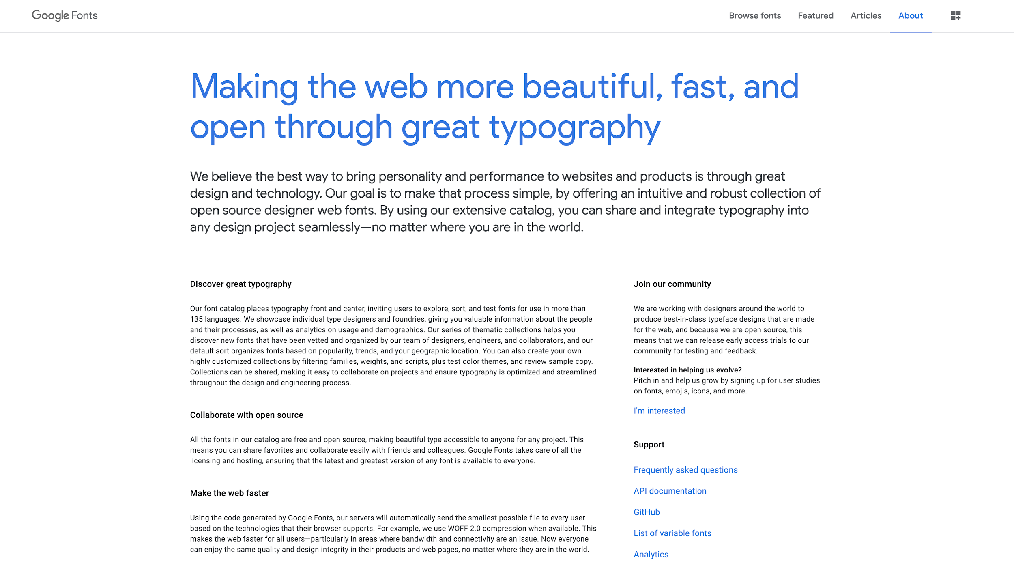
Notes:
I’m Dave Crossland, and I’m the lead program manager for Google Fonts, focused on font development.
This is our about page where you can see what we are about - fonts.google.com/about

Slide 3
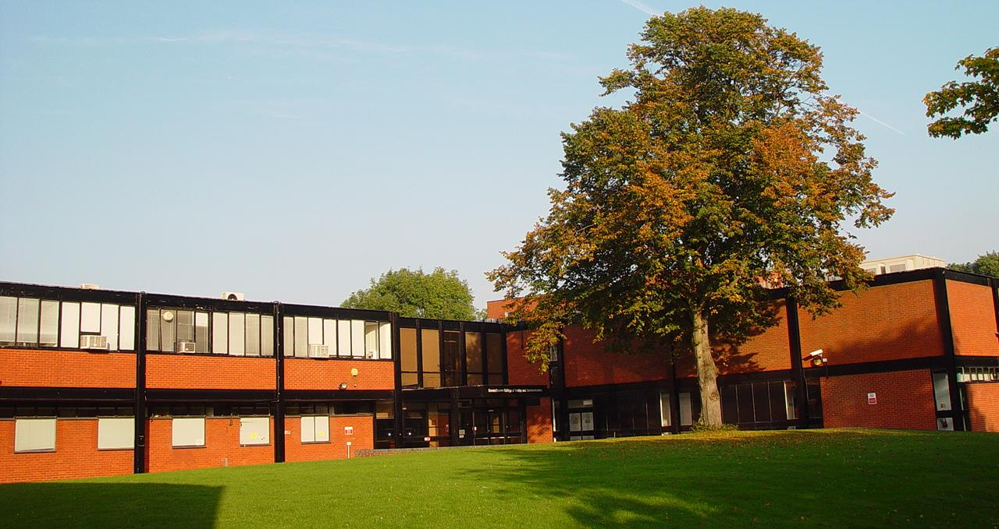
Notes:
I did undergraduate interaction design studies at rave.ac.uk when it was at its previous campus in Kent, 2002 to 2006.

Slide 4
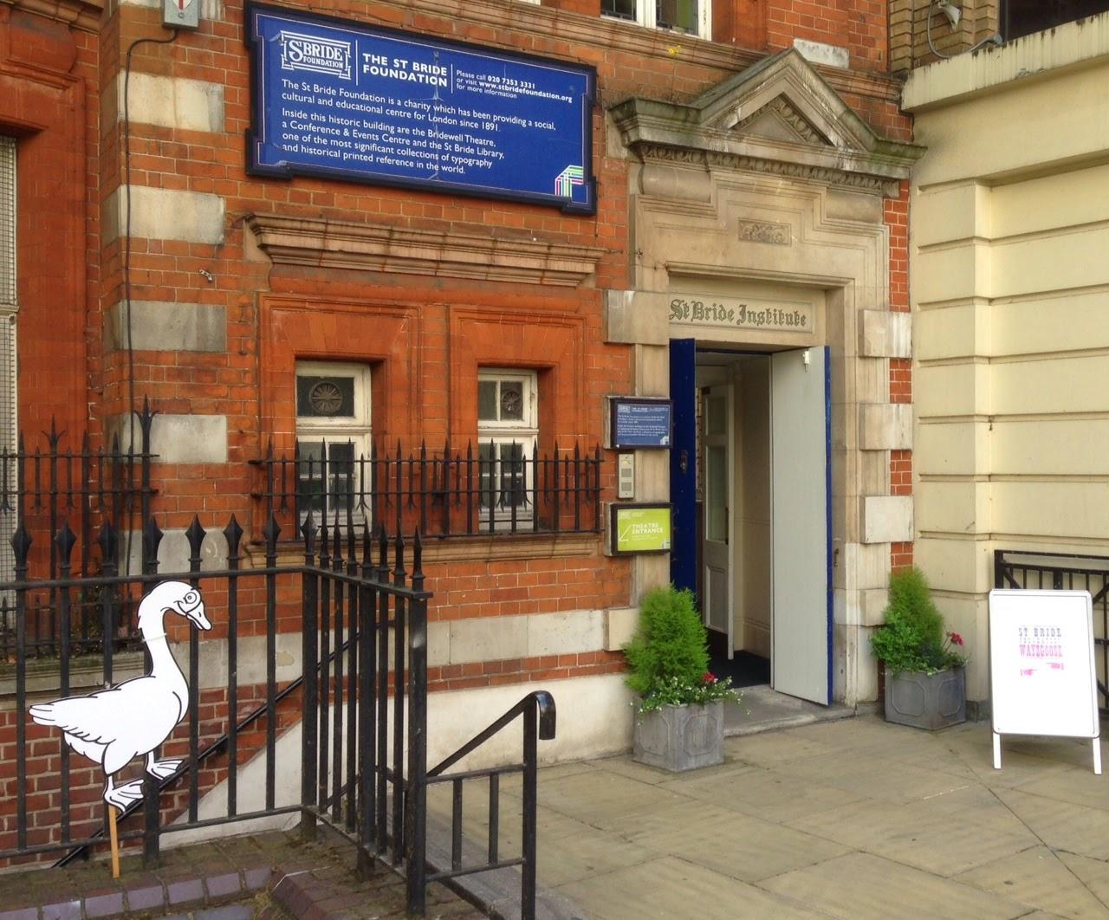
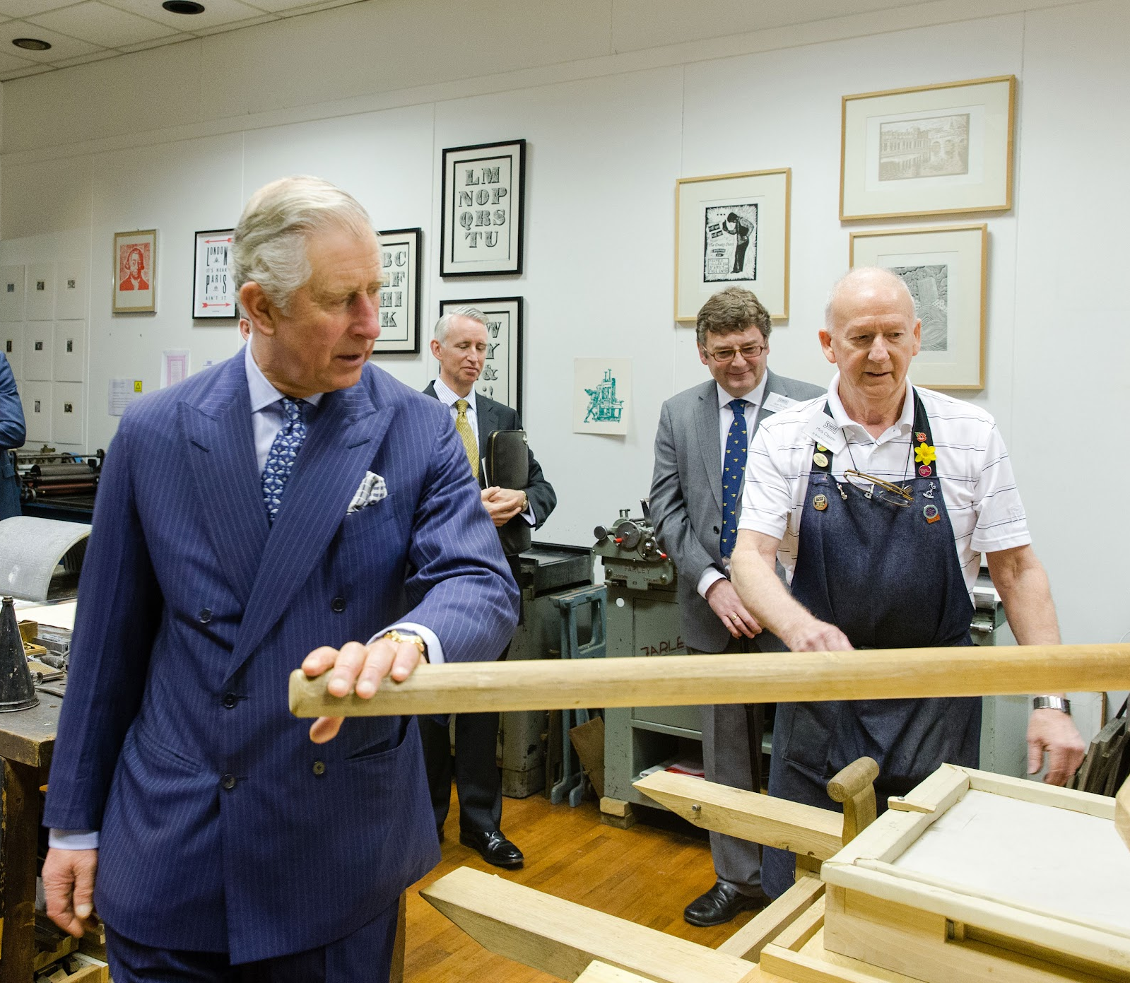
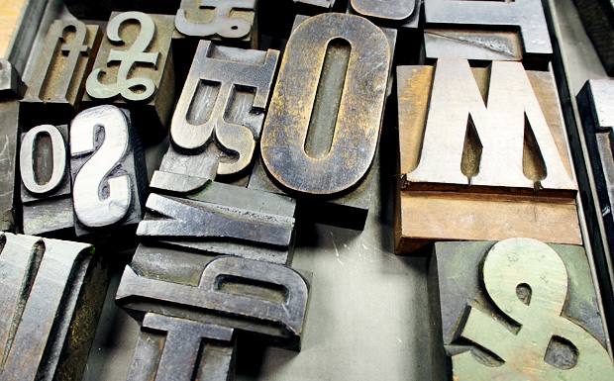
Notes:
In this period I attended many events about typography at the St Bride Library stbride.org.uk

Slide 5
Notes:
In this period I attended many events about typography at the St Bride Library (stbride.org.uk), “one of the most significant collections of typography and historical printed reference in the world.”

Slide 6
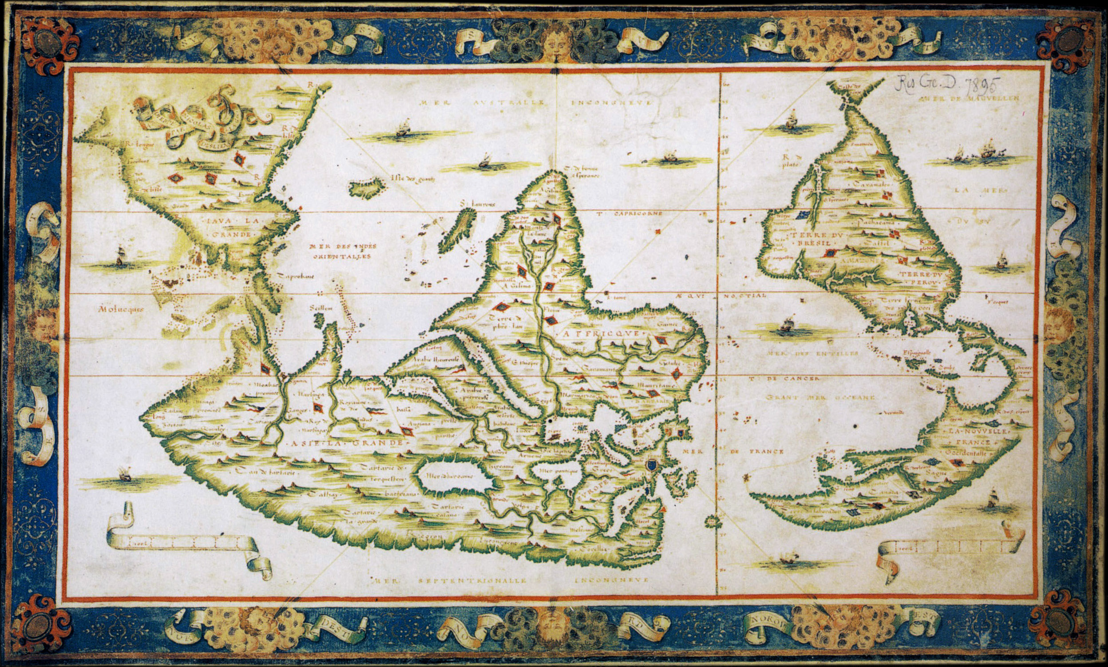
fr.wikipedia.org/wiki/Fichier:Nicolas_Desliens_Map_(1566).jpg
Notes:
This historical archive gave me a real feeling for the global importance of typography. I love all the different maps and mapped projections of the globe, because they show how our perceptions can be skewed.

Slide 7
fr.wikipedia.org/wiki/Fichier:Nicolas_Desliens_Map_(1566).jpg
Notes:
This map from nearly 500 years ago makes Europe extremely large.

Slide 8
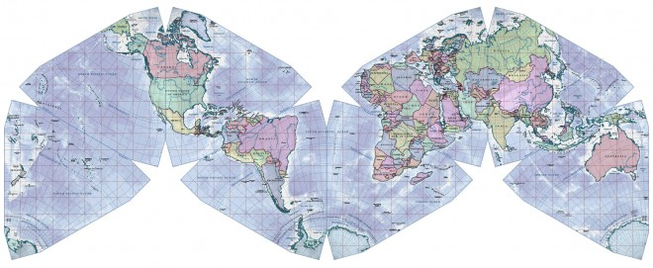
Notes:
Here’s a more accurate projection, where europe (and greenland) are the right size. Typography has also been rather euro-centric for 500 years, but I learned at St Bride that this is changing in the 21st century, and I’m proud of my work to be part of that change.

Slide 9
Visual culture
Language Technology Business
History
Notes:
I really fell in love with typeface design, because it combines all these disparate areas of knowledge and skills.

Slide 10
Visual culture
Language Technology Business
History
Ubiquity
Notes:
And ultimately, because it is absolutely everywhere.

Slide 11
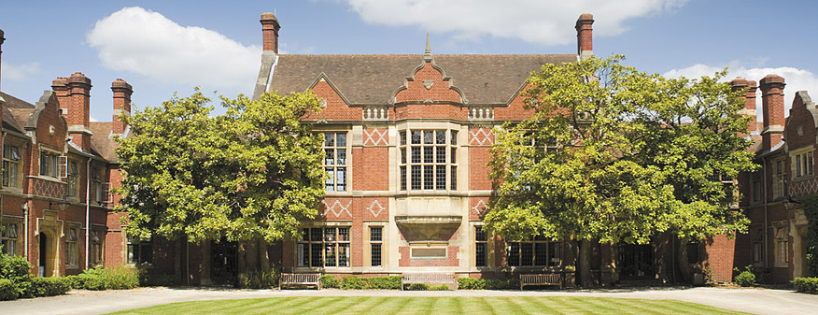
Notes:
So I went to study typfeace design at the University of Reading (in the town called Reading, not a fake degree I bought on the internet :)
www.typefacedesign.org

Slide 12
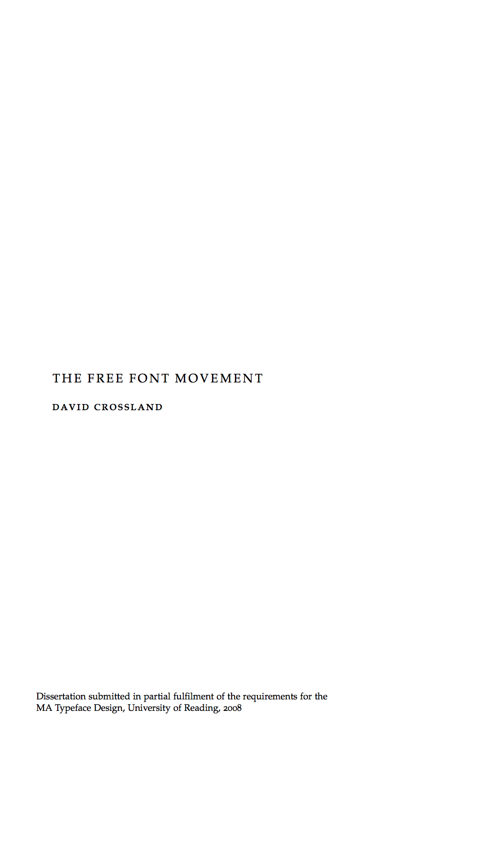
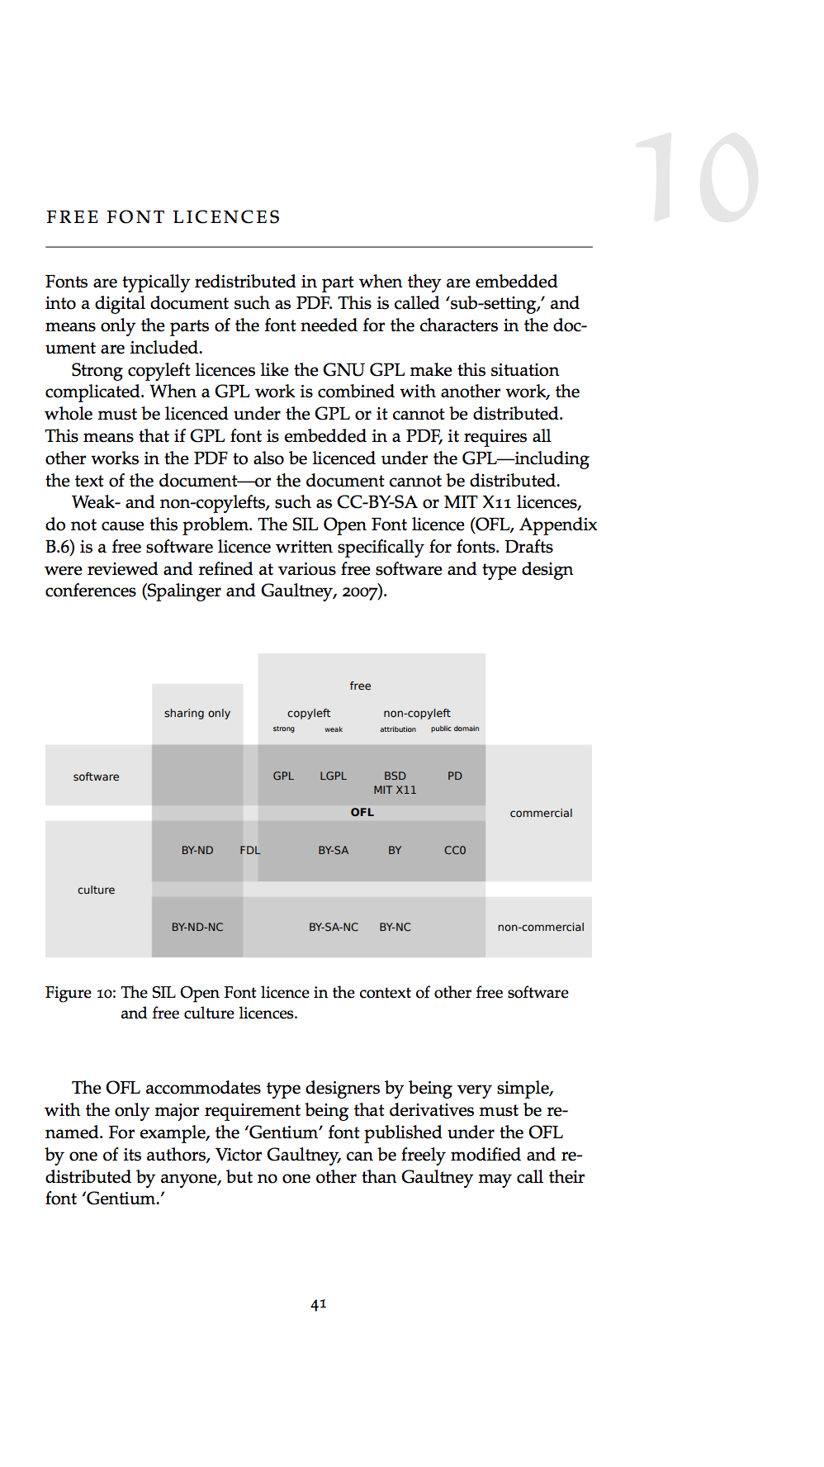
Notes:
In 2008 I did my dissertation on libre fonts (http://davelab6.github.io/matd-dissertation)

Slide 13
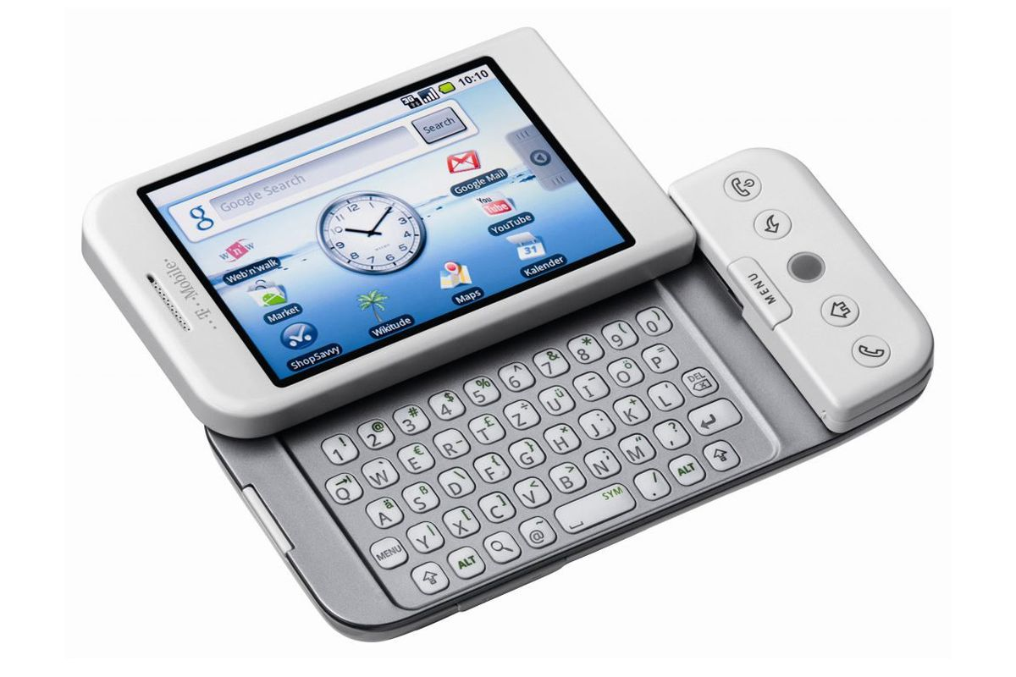
Cantarell The Quick Brown 0123456789.,?!;;@#$%&*()[]{}/\<>”+ Fox Jumps Over ABCDEFGHIJKLMNOPQRSTUVWXYZ The Lazy Dog abcdefghijklmnopqrstuvwxyz
Gg
Notes:
And in 2009, I made my first complete typeface for a better reading experience on the first android phone (https://fonts.google.com/specimen/Cantarell). This was at a special time, right at the start of web fonts.

Slide 14
Variable Fonts
Notes:
And right now is also a special time, right at the start of variable fonts. This is the main topic I am presenting to you all today.

Slide 15
Skia, Matthew Carter, 1994
Notes:
Here’s “Skia,” a typeface by Matthew Carter
that Apple commissioned in the early 90s,
and is still in Mac OS X and iOS today.
It has weight and width axes,
light to bold,
and narrow to wide.
From http://www.monotype.com/blog/articles/part-1-from-truetype-gx-to-variable-fonts/

Slide 16
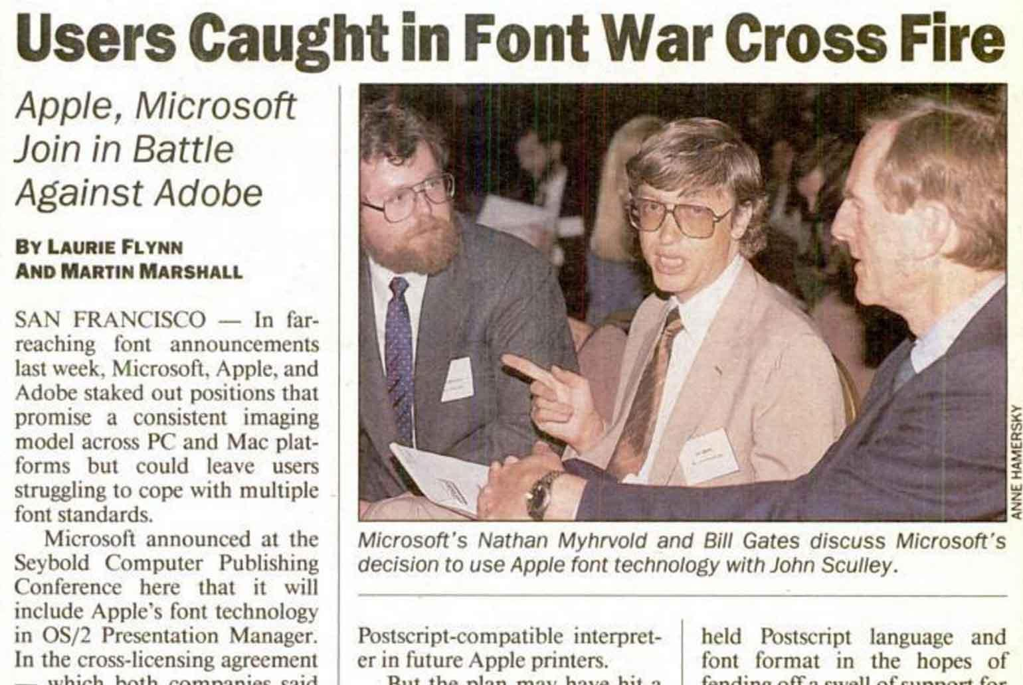
monotype.com/blog/articles/part-1-from-truetype-gx-to-variable-fonts
Notes:
This technology is a little bit “back to the future”
It originates in the late 80s and early 90s at the end of the Cold War
when “micro’s” were giving way to “PCs” and Apple and Microsoft
were duking it out with Amiga and Atari for the home market,
with Sun and IBM for the business market,
and with Adobe for the Desktop Publishing
and “Multimedia” CD-ROM markets.
From http://www.monotype.com/blog/articles/part-1-from-truetype-gx-to-variable-fonts/

Slide 17
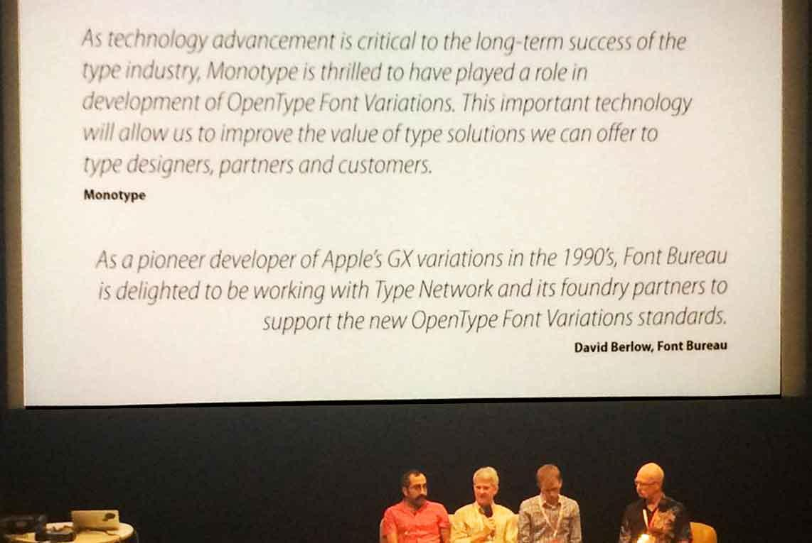
ATypI, Warsaw, September 2016
monotype.com/blog/articles/part-1-from-truetype-gx-to-variable-fonts
Notes:
Here’s our Behdad (Google i18n Font & Text team)
Peter Constable (Microsoft Windows Platform APIs team)
Ned Holbrook (Apple Font team)
and David Lemon (Adobe Type team)
announcing the format at the annual
International Typographic Association (“ay-tie-pee”) conference,
late last year.
http://www.monotype.com/blog/articles/part-1-from-truetype-gx-to-variable-fonts/
https://www.youtube.com/watch?v=6kizDePhcFU

Slide 18
Google, Microsoft, Apple, Adobe
monotype.com/blog/articles/part-1-from-truetype-gx-to-variable-fonts
Notes:
These huge tech platforms’
engineering management chains
came to agree to make this happen,
cross platform, all at the same time,
because there is a very compelling engineering case for it.
http://www.monotype.com/blog/articles/part-1-from-truetype-gx-to-variable-fonts/
https://www.youtube.com/watch?v=6kizDePhcFU

Slide 19
Ubiquity
monotype.com/blog/articles/part-1-from-truetype-gx-to-variable-fonts
Notes:
And this overcomes the main obstacle that previous attempts to ship this kind of font faced before: As an open standard that is implemented by the largest platforms, they can work everywhere.
In the past, they were single-vendor technologies, that failed to create the necessary network effects for adoption at scale.

Slide 20
Compress
Express
Finesse
Notes:
And this is not technology looking for a problem to solve.
I see 3 kinds of benefits for users here.

Slide 21
Compress
Express
Finesse
Notes:
First, lets look at the benefit to compress fonts.

Slide 22
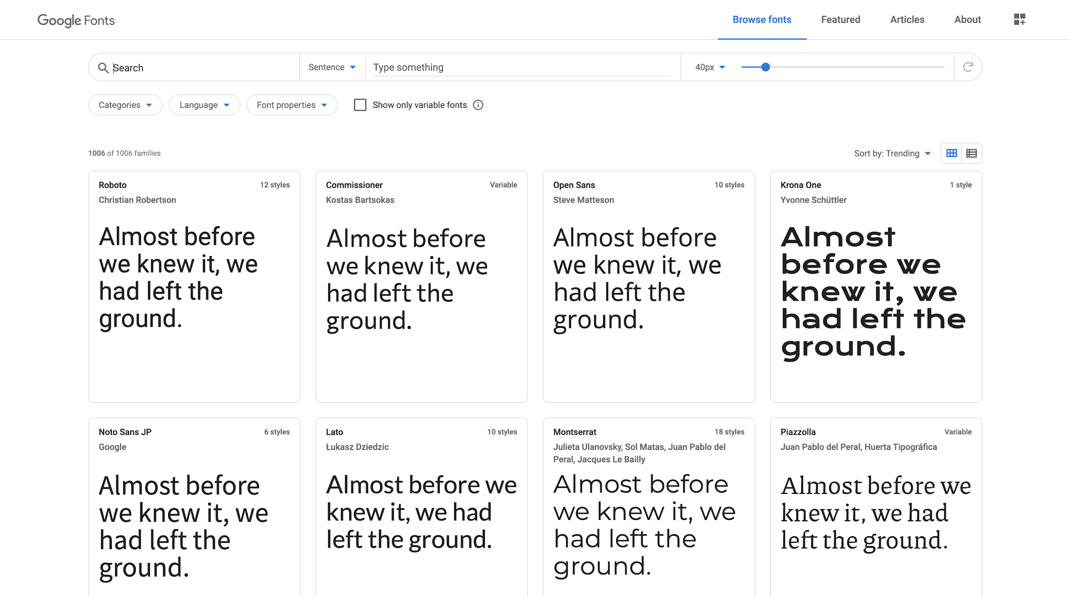
Notes:
Here’s GF today

Slide 23
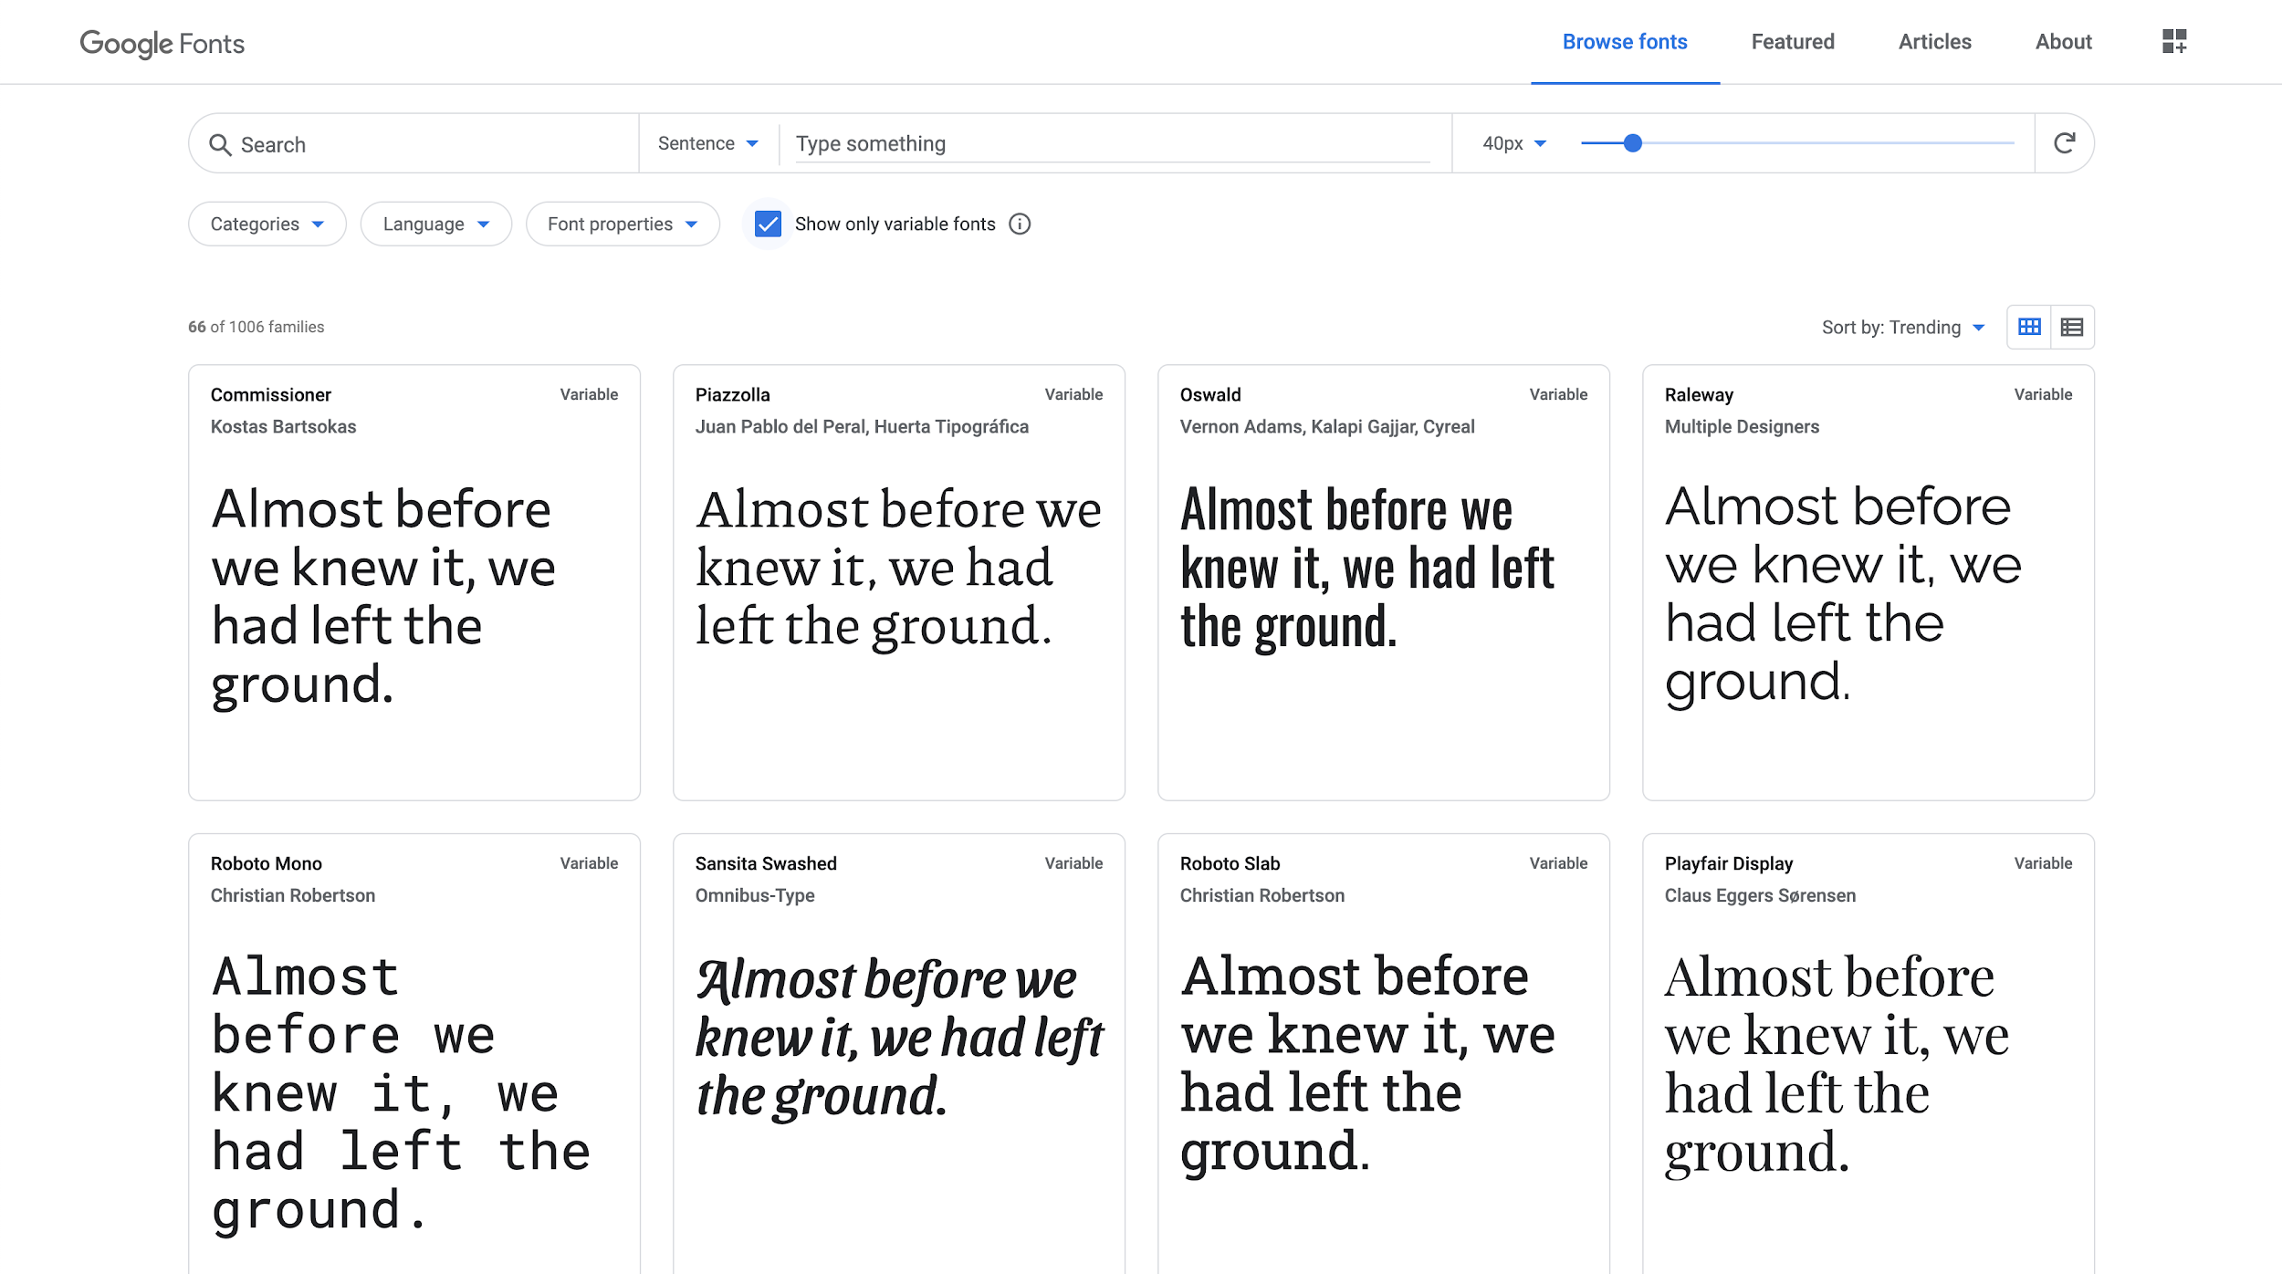
Notes:
And here’s the filter to see only VFs.
Most have just 1 axis, Weight.

Slide 24
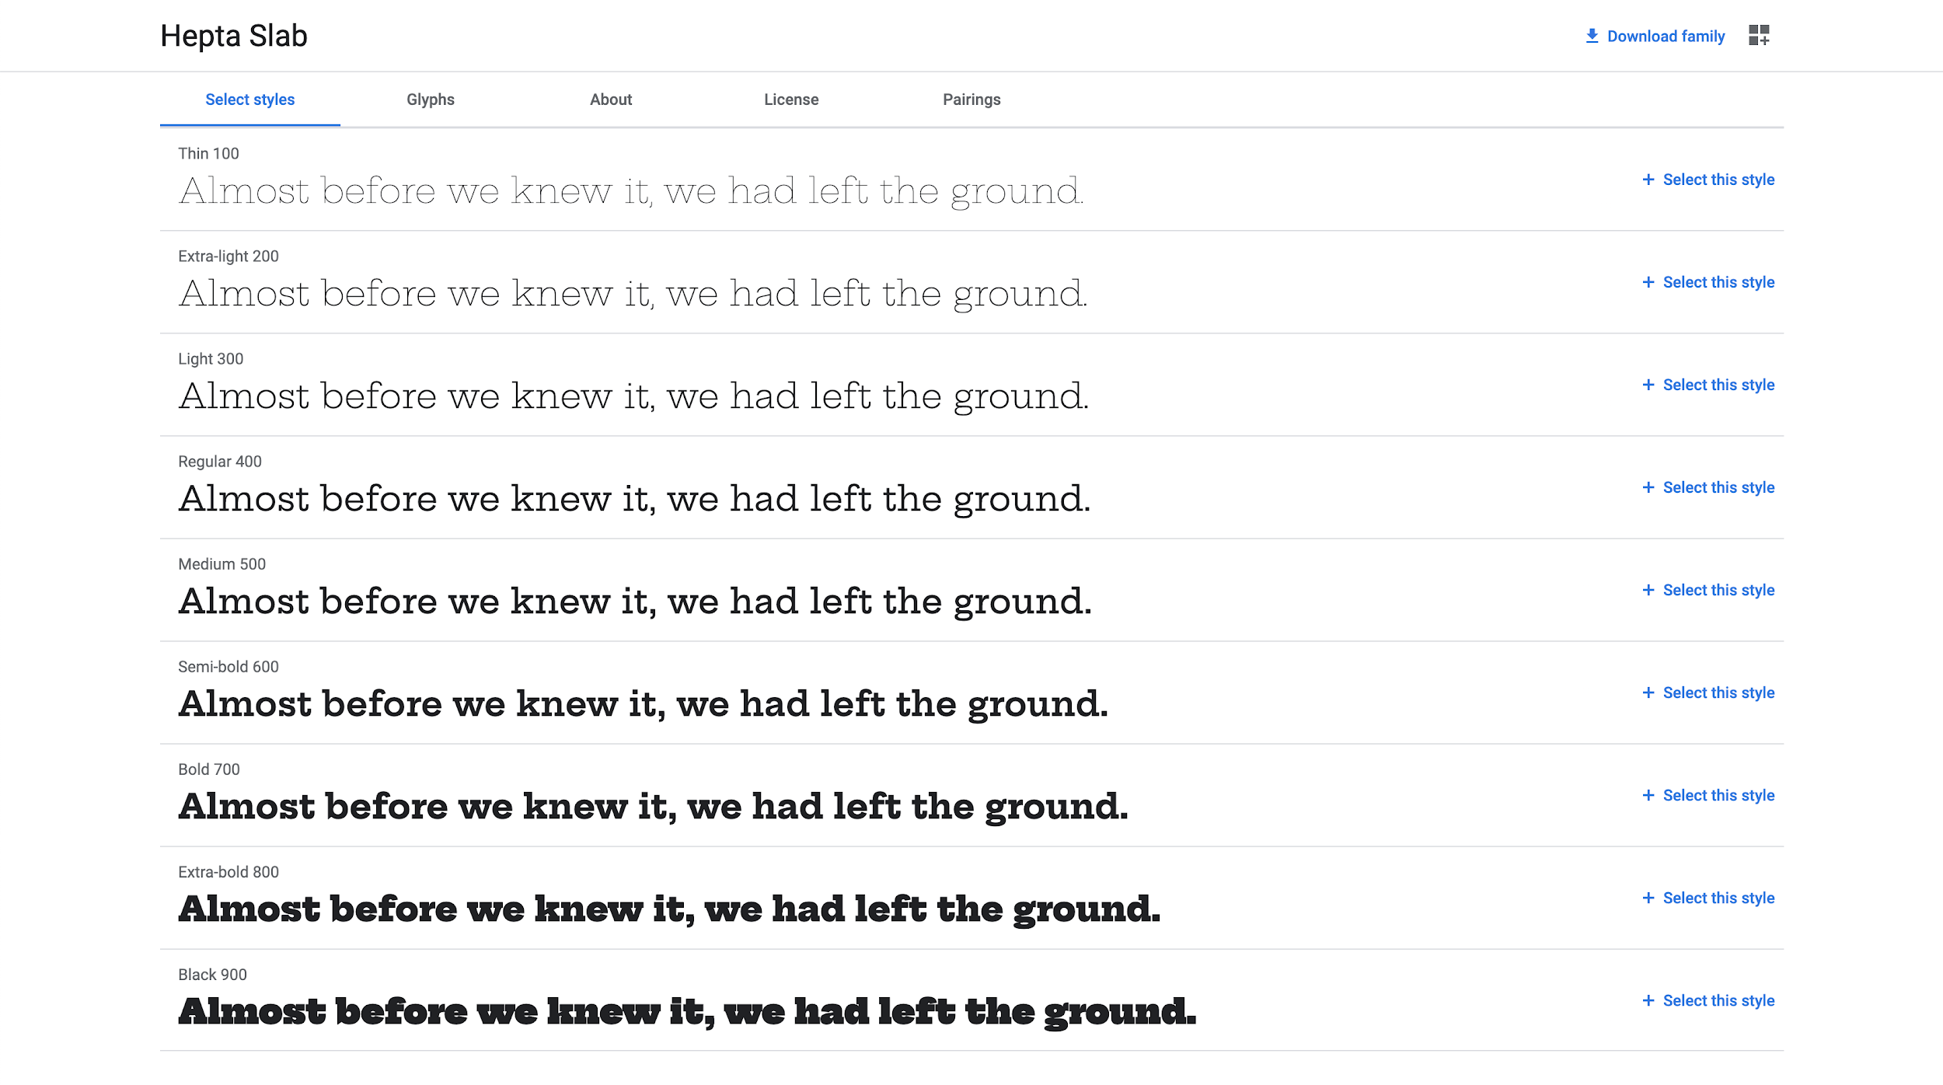
Notes:
Here’s the Hepta Slab family. Each weight is about the same file size as the other.

Slide 25
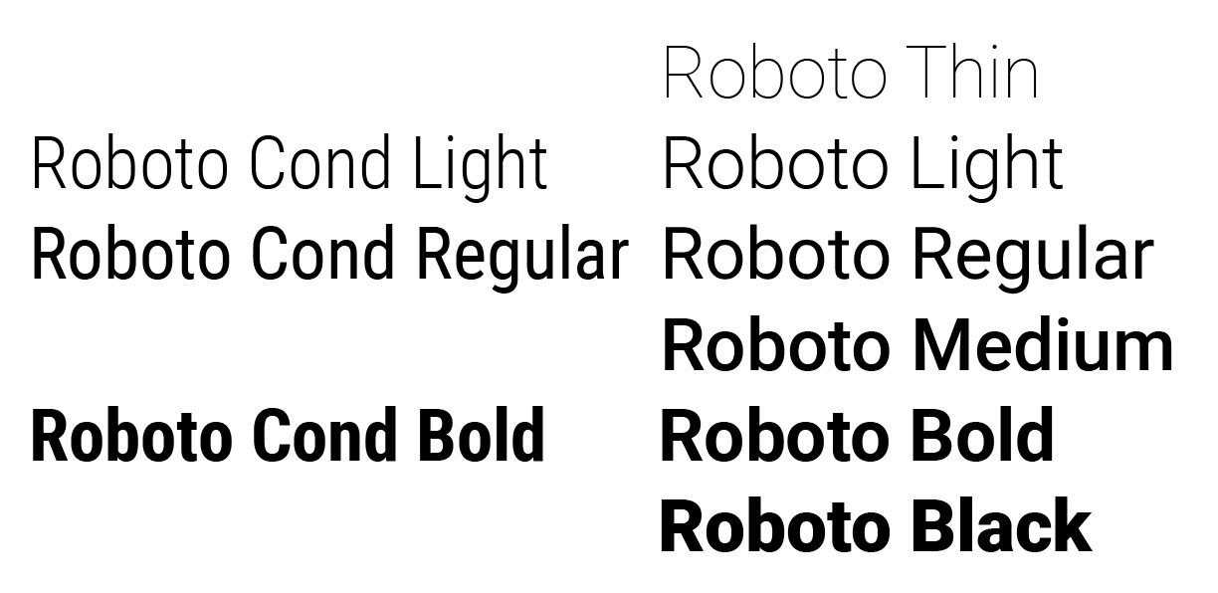
Notes:
“Static” Roboto has 6 weights with a normal width, and 3 weights with a condensed width (plus italics for all)

Slide 26
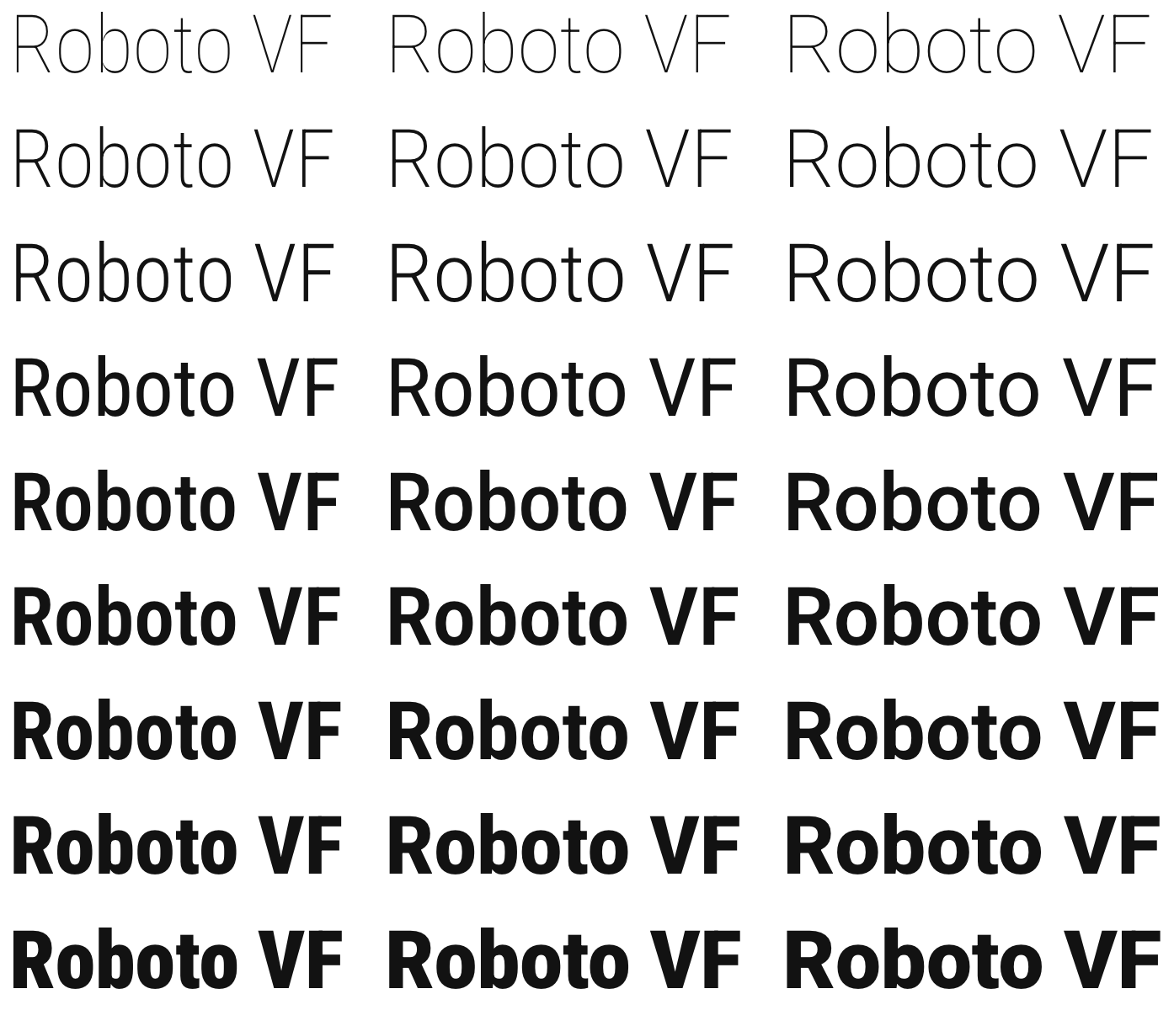
Notes:
Roboto VF re-maps the existing design to a grid of width x weight, and allows users to access eg Condensed Thin, which wasn’t possible before.
But for existing styles, the result should be 1:1 the same as before, down to the pixel.

Slide 27
Notes:
Roboto VF re-maps the existing design to a grid of width x weight, and allows users to access eg Condensed Thin, which wasn’t possible before.
But for existing styles, the result should be 1:1 the same as before, down to the pixel.

Slide 28
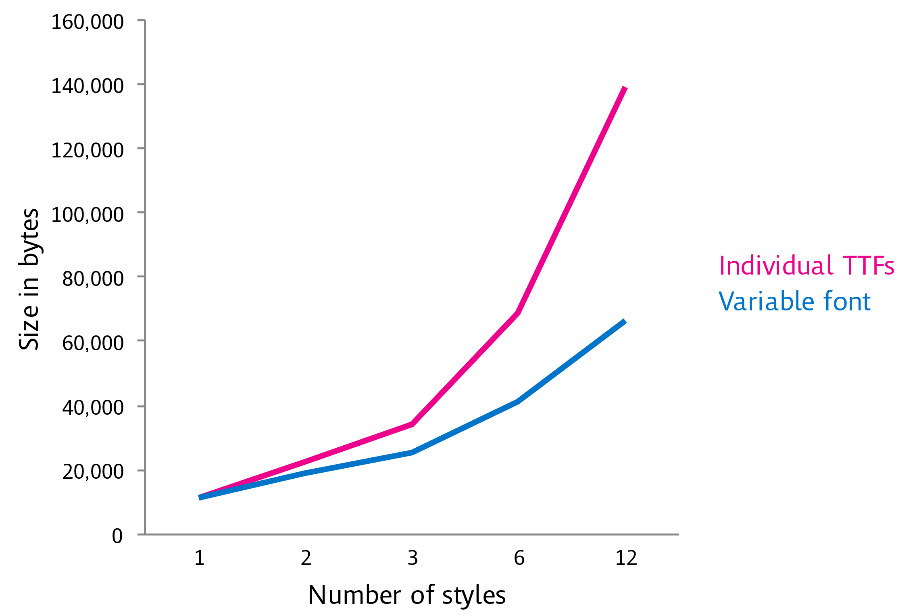
monotype.com/blog/articles/part-1-from-truetype-gx-to-variable-fonts
Notes:
These gains can be achieved for large sets of weight and width styles,
such as within families like Roboto.
The more static styles you are replacing the bigger the benefit.
Or, you can now use more styles than you used to, enabling better typography, although not new typography per-se.
http://www.monotype.com/blog/articles/part-2-from-truetype-gx-to-variable-fonts/

Slide 29
Compress
Express
Finesse

Slide 30
Notes:
Here’s Hepta again, in its regular weight.

Slide 31
Notes:
The weight axis can also be expressive. Very bold!

Slide 32
Notes:
This is the “Thin” (100) weight, as you might see before variable fonts.

Slide 33
Notes:
As a VF, this family goes all the way down to “1”.
This only works at large sizes, and I’ll return to this point later.

Slide 34
Notes:
What is there beyond weight?
Back in 2016 when this tech was announced, we began working with a very senior type designer.

Slide 35
Notes:
David Berlow, who started designing type as his full time focus in the mid 1970s, and hasn’t stopped since.

Slide 36
Notes:
David made 2 fonts for us in 2016, and the first is Decovar, a decorative geometric sans serif art-deco variable font.

Slide 37
Notes:
It has dozens of styles within it

Slide 38
Notes:
And even a special Bold style.

Slide 39
fontbureau.typenetwork.com
Notes:
These all combine!
There are 10,000s of possibilities in just 1 font file.
https://www.typenetwork.com/brochure/decovar-a-decorative-variable-font-by-david-berlow/

Slide 40
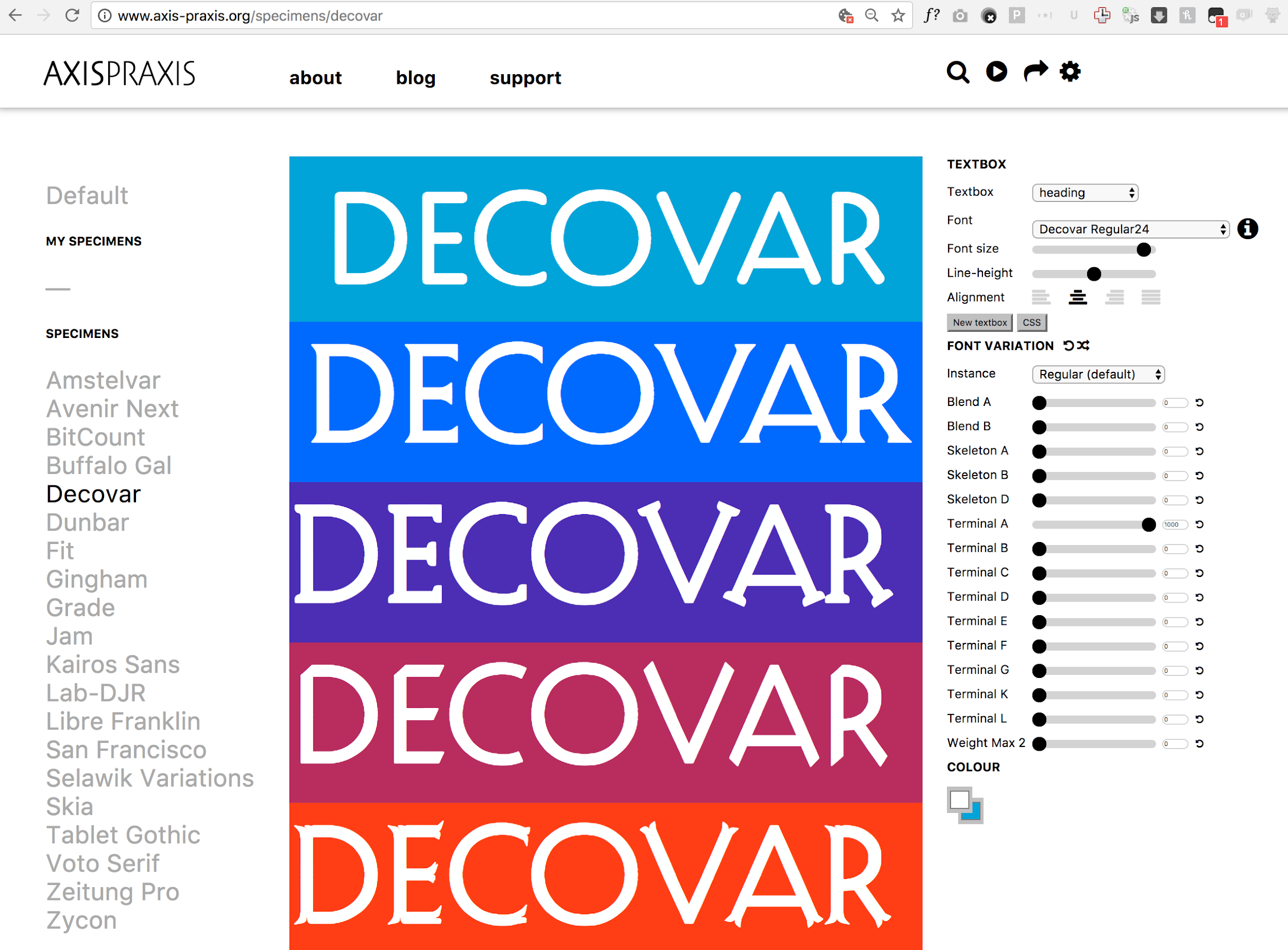
Notes:
A great site for checking it out is Axis Praxis.
As you can see, there are many different
Skeleton and Terminal axes,
and they can be blended together.
Check out the “fancy” and “mayhem” named instances!
http://www.axis-praxis.org/specimens/decovar

Slide 41
Adobe “Multiple Master” Model
monotype.com/resources/articles/part-1-from-truetype-gx-to-variable-fonts
Notes:
Many type designers use font editors that provide VF style features for designing with based on the older adobe tech model.

Slide 42
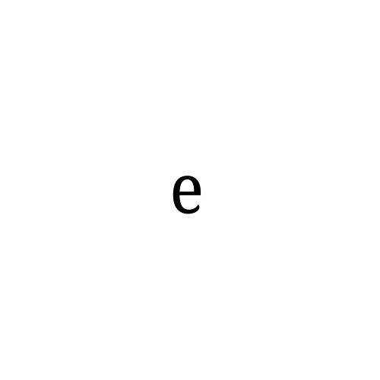
Apple “GX” Model
monotype.com/resources/articles/part-1-from-truetype-gx-to-variable-fonts
Notes:
But VF is based on the older Apple tech, which has a different model, which Decovar demonstrates.

Slide 43
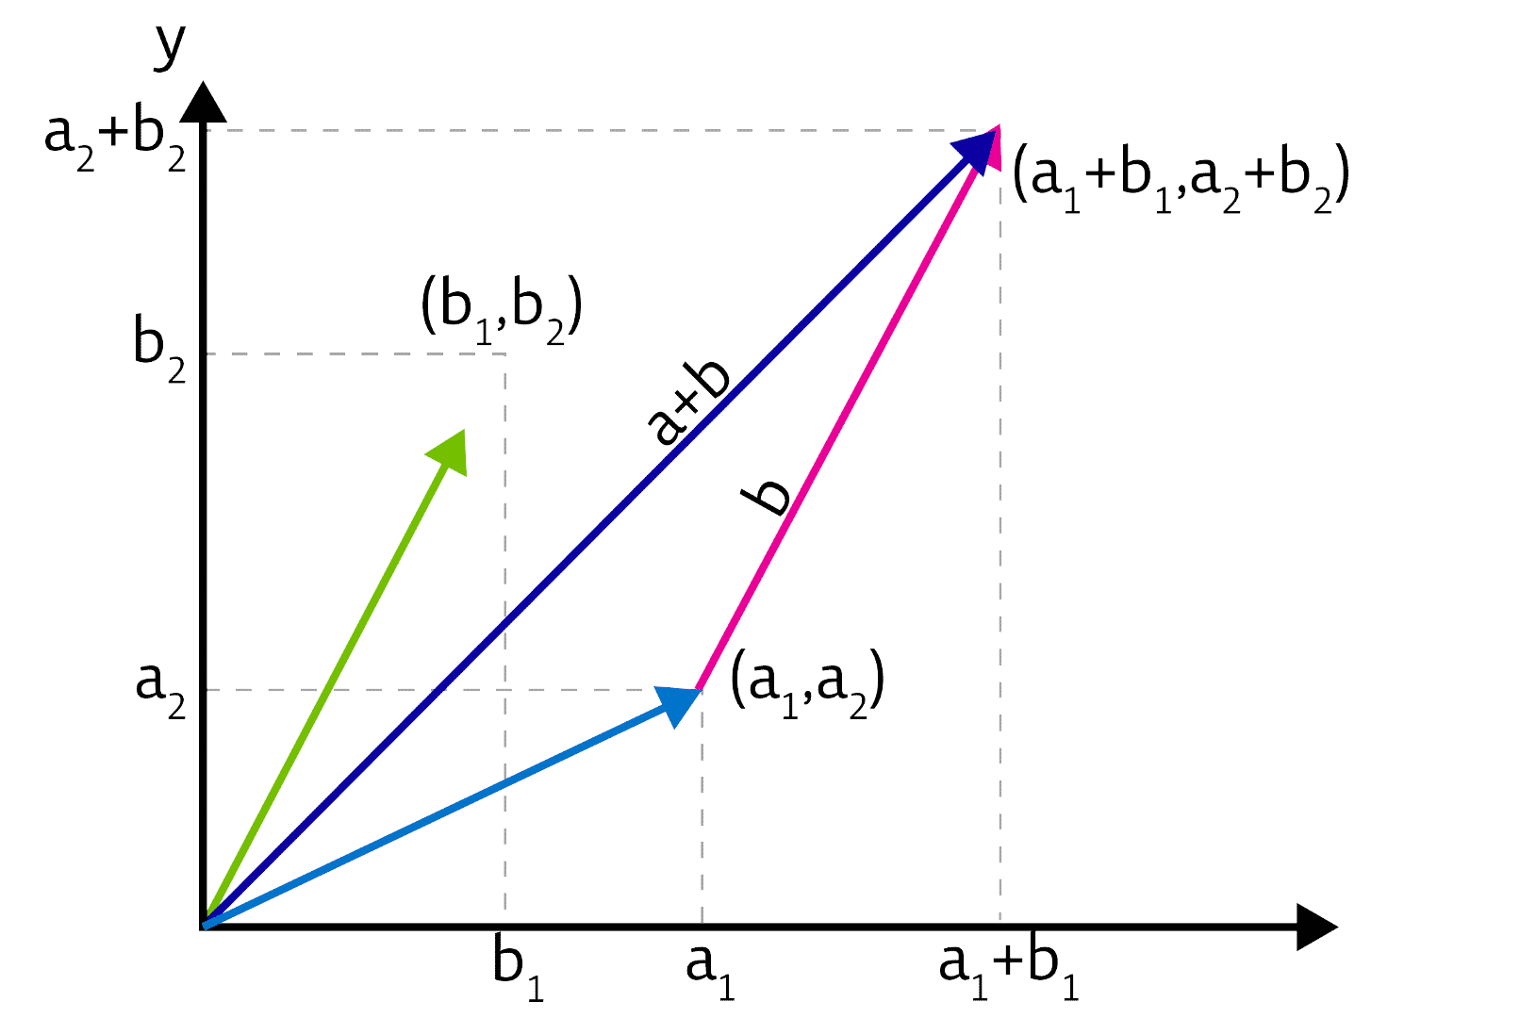
monotype.com/blog/articles/part-1-from-truetype-gx-to-variable-fonts
Notes:
It is the kind of concept you can find in a high school AP Math class.
Not many type designers took those classes, though.
I certainly didn’t!
So what this means for type design is a little far-out for many of them.
But David Berlow has had 25 years to think it through.
http://www.monotype.com/blog/articles/part-1-from-truetype-gx-to-variable-fonts/

Slide 44
Compress
Express
Finesse
Notes:
3rd benefit is to fine typography, and maybe users do not slide slides, they set conditions to determine the slider values.

Slide 45
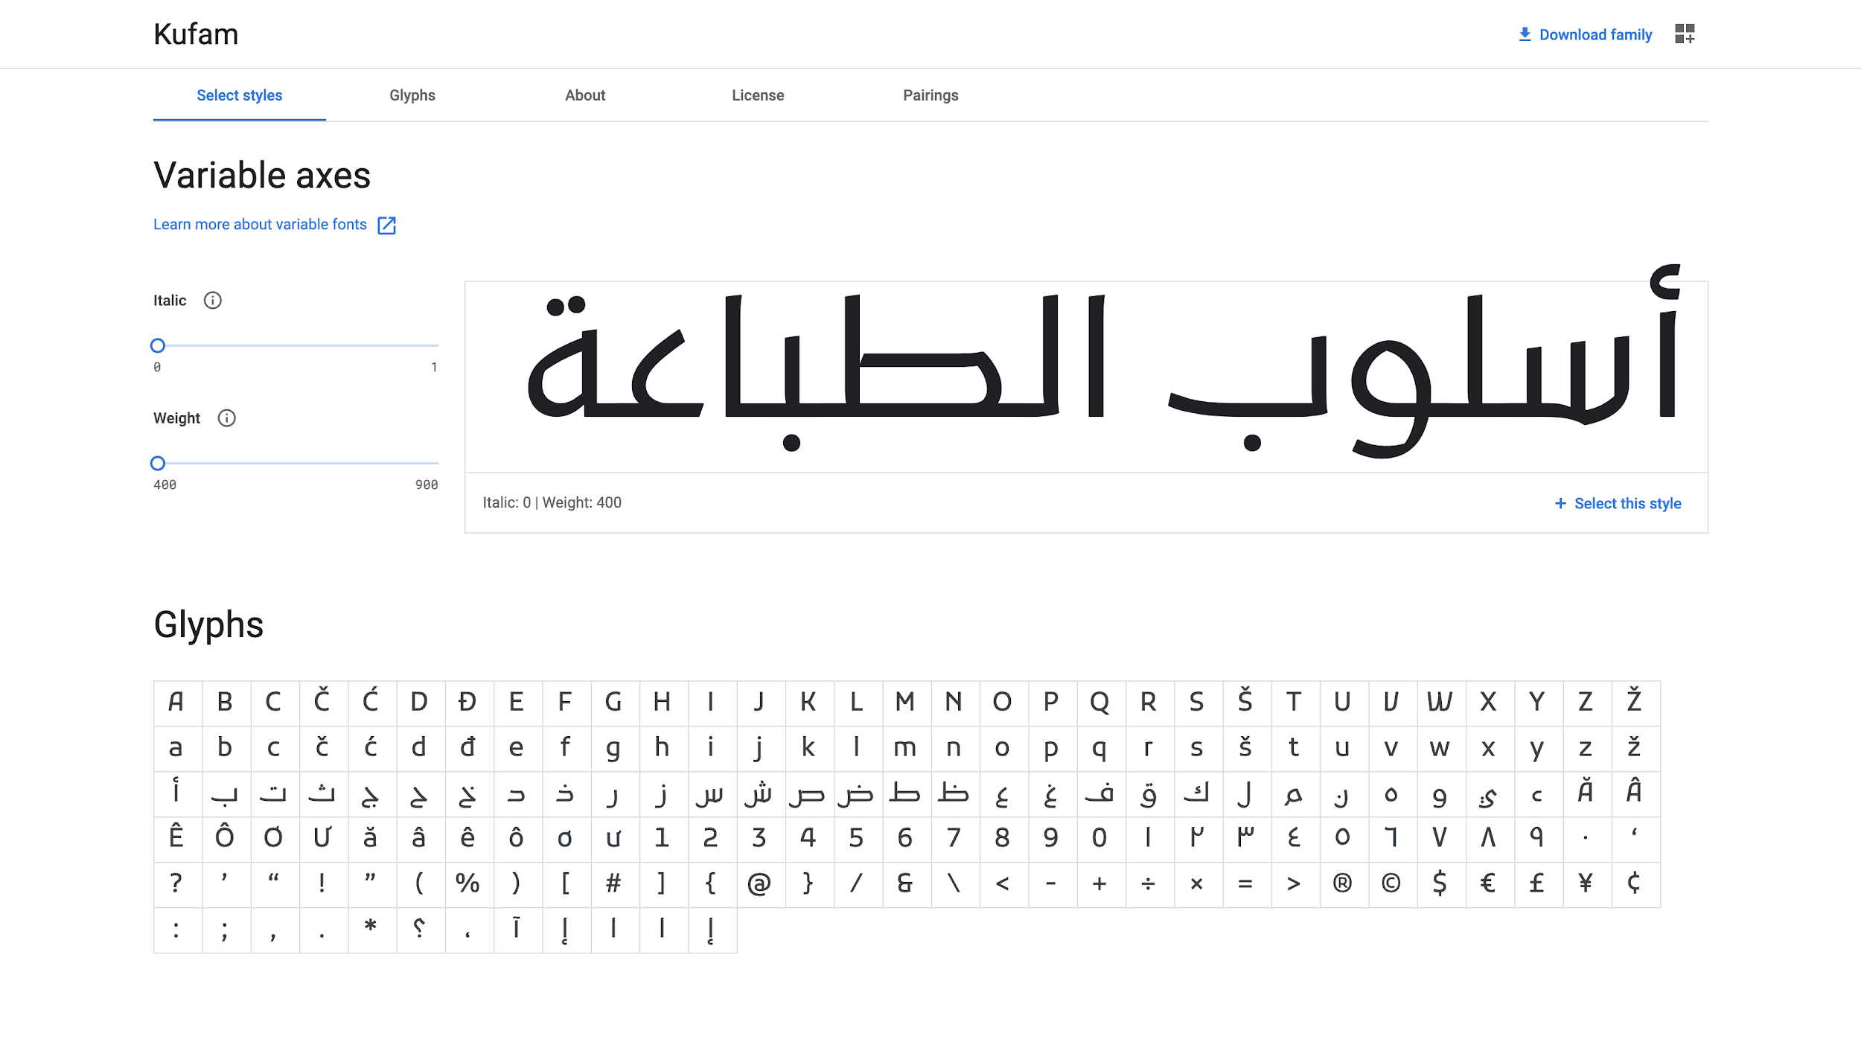
Notes:
Here’s a sample headline.

Slide 46
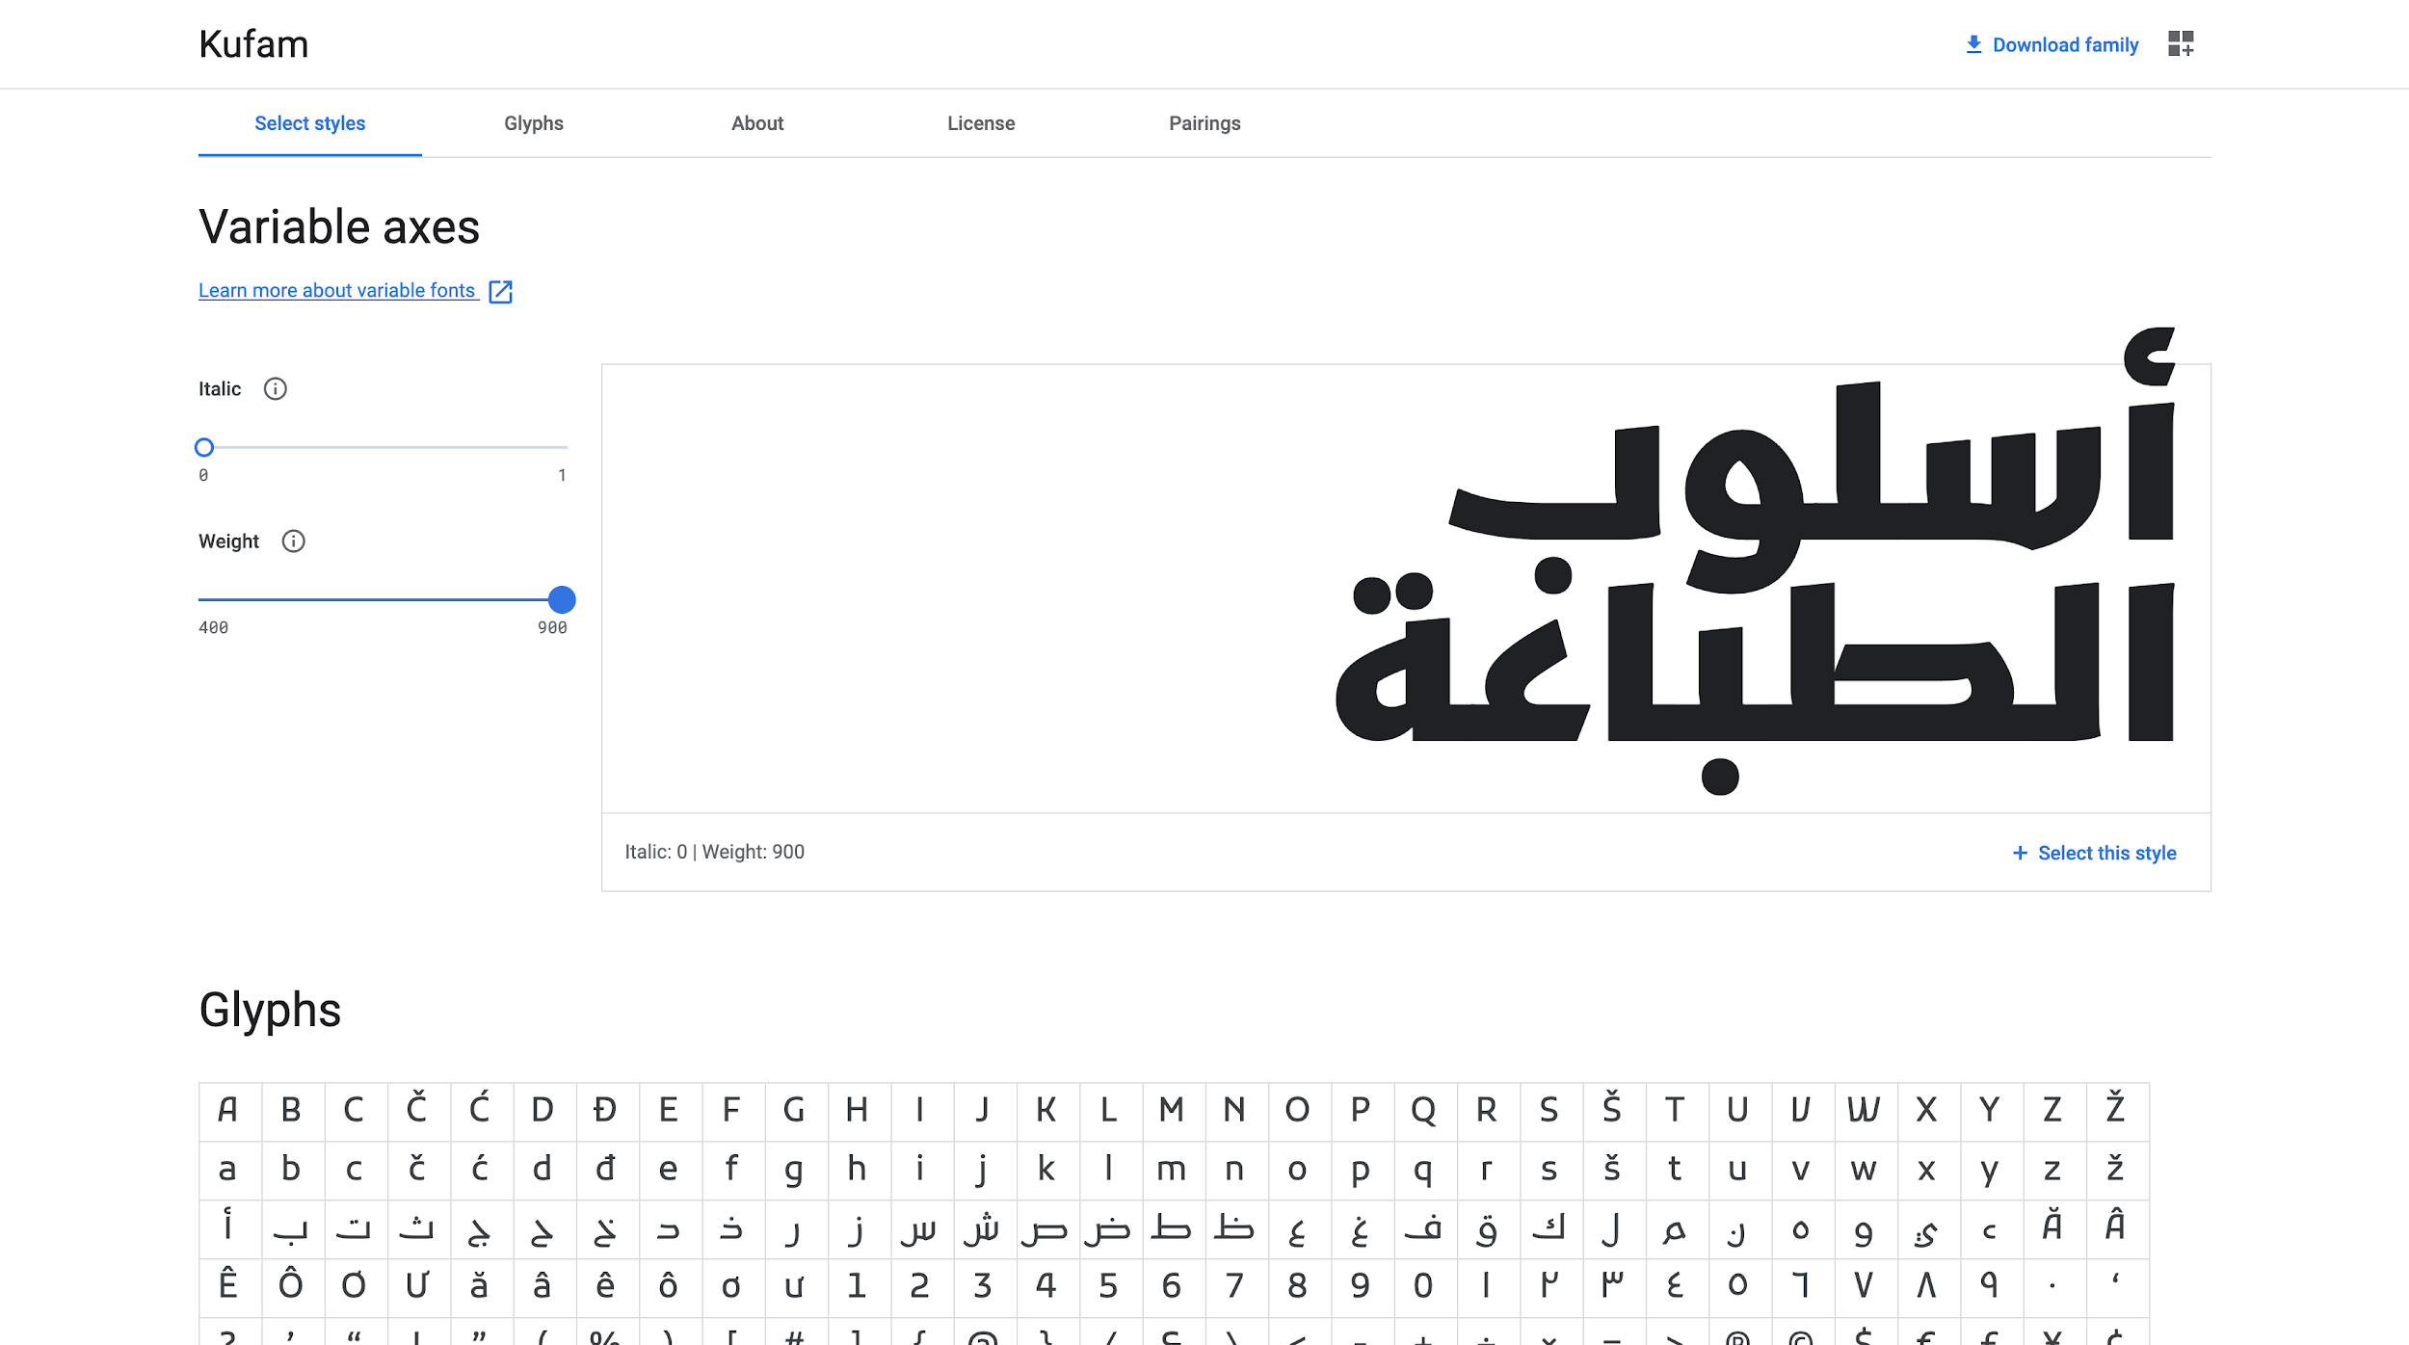
Notes:
As it gets bolder, it gets wider.

Slide 47
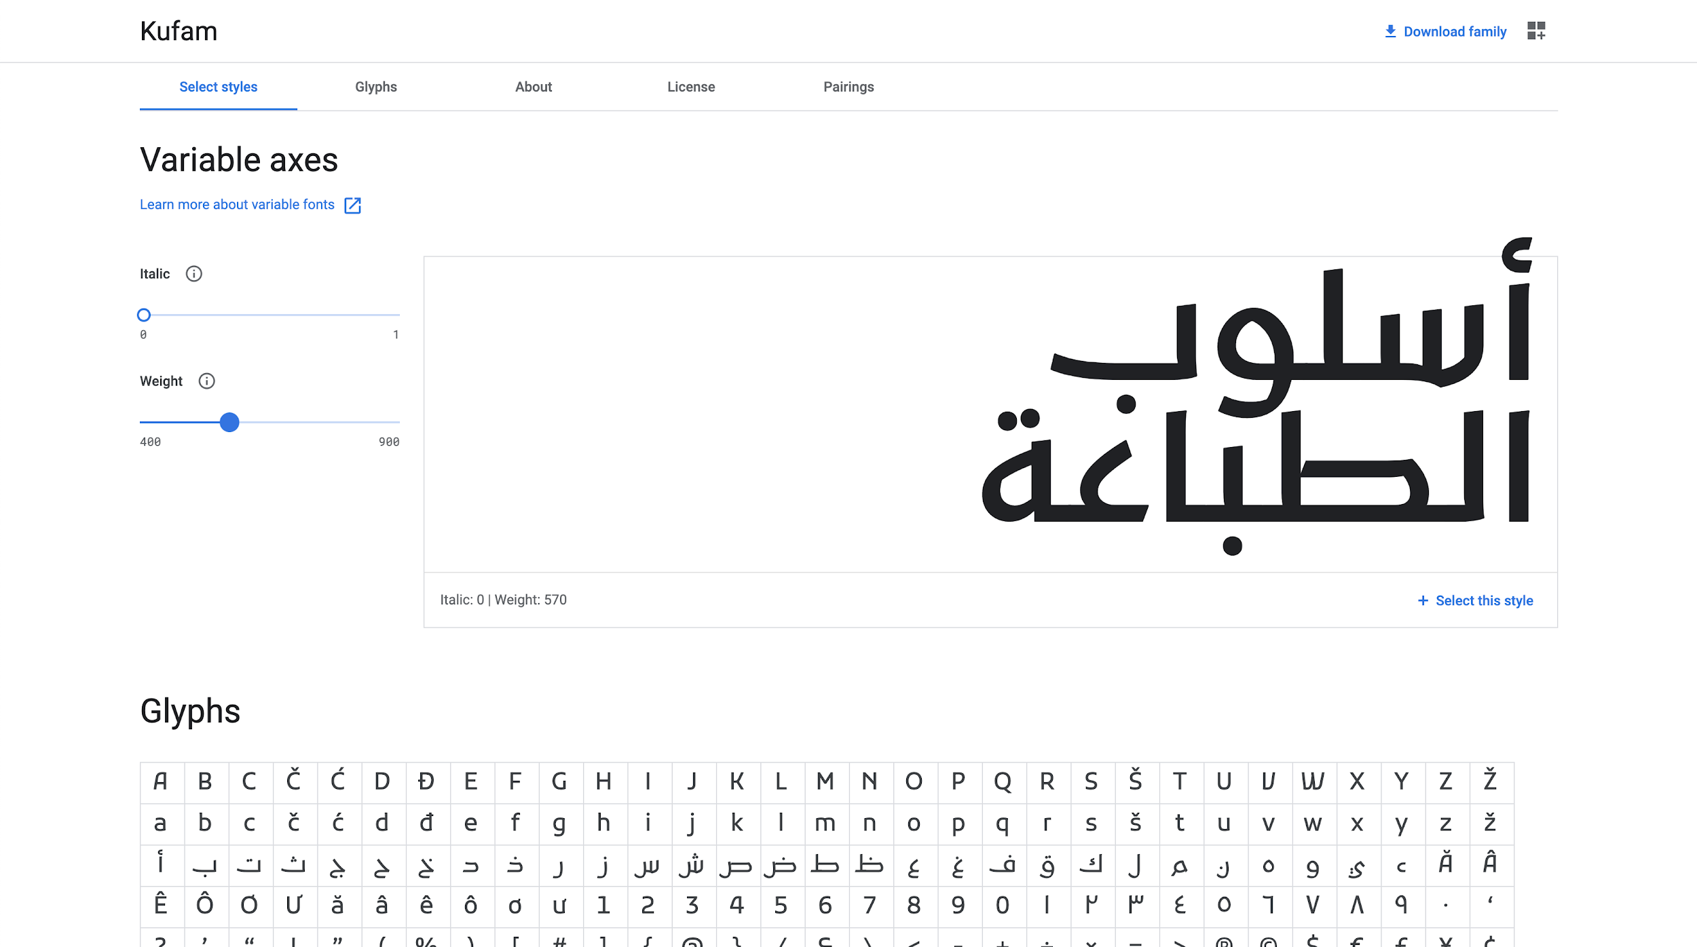
Notes:
A headline might be a middle weight, but this is still too wide to fit on 2 lines.

Slide 48
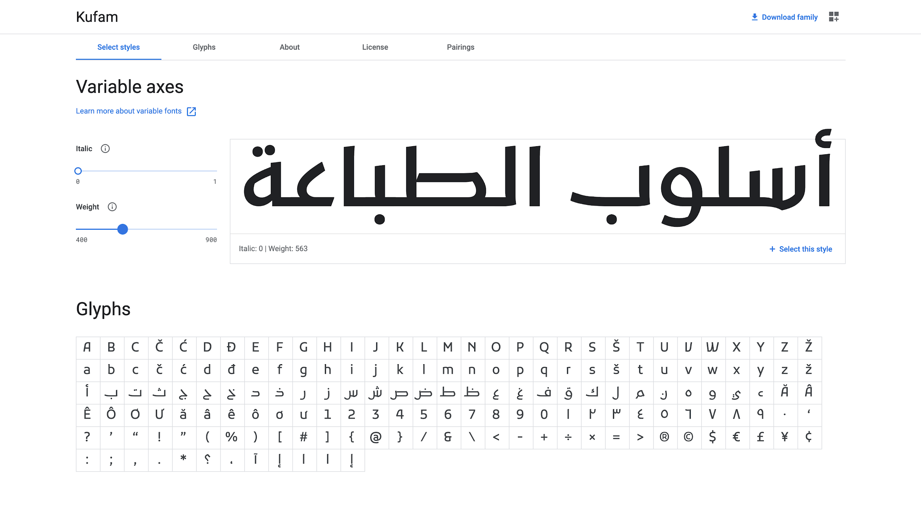
Notes:
But just 1 step lighter, and it fits!
This ‘fit to box’ or ‘fit to line’ heuristic can be automated.

Slide 49
Optical Size
Notes:
One of the most important finesse automations is optical size.
I want to dive deeper into this.

Slide 50
Notes:
The 2nd project I commissioned from Font Bureau
is this serif text font, Amstelvar.
It is kind of a boring design. A Dutch newspaper type,
intended for use at 12pt.
But for me, this is MUCH more exciting than Decovar!
I’m a graduate from the University of Reading’s
Department of Typography,
and there is a real dedication to “text typefaces” there.
The reason I find it exciting is that David is using
“blending” as a powerful new approach to text typography.
And this is what makes Variable Fonts technology meaningful.
https://www.typenetwork.com/brochure/opentype-variable-fonts-moving-right-along/

Slide 51
Notes:
Here is the design for usage at 6pt.
The thins (e’s bar, and serifs) get thicker.
The spacing and rhythm is looser.
At small sizes, it stays easy to read.
https://www.typenetwork.com/brochure/opentype-variable-fonts-moving-right-along/

Slide 52
Notes:
And here is the design for 96pt.
The thins (e’s bar, and serifs) get very thin.
The spacing and rhythm is tighter.
At large sizes, it is more beautiful.
https://www.typenetwork.com/brochure/opentype-variable-fonts-moving-right-along/

Slide 53
Notes:
Here you can compare them

Slide 54
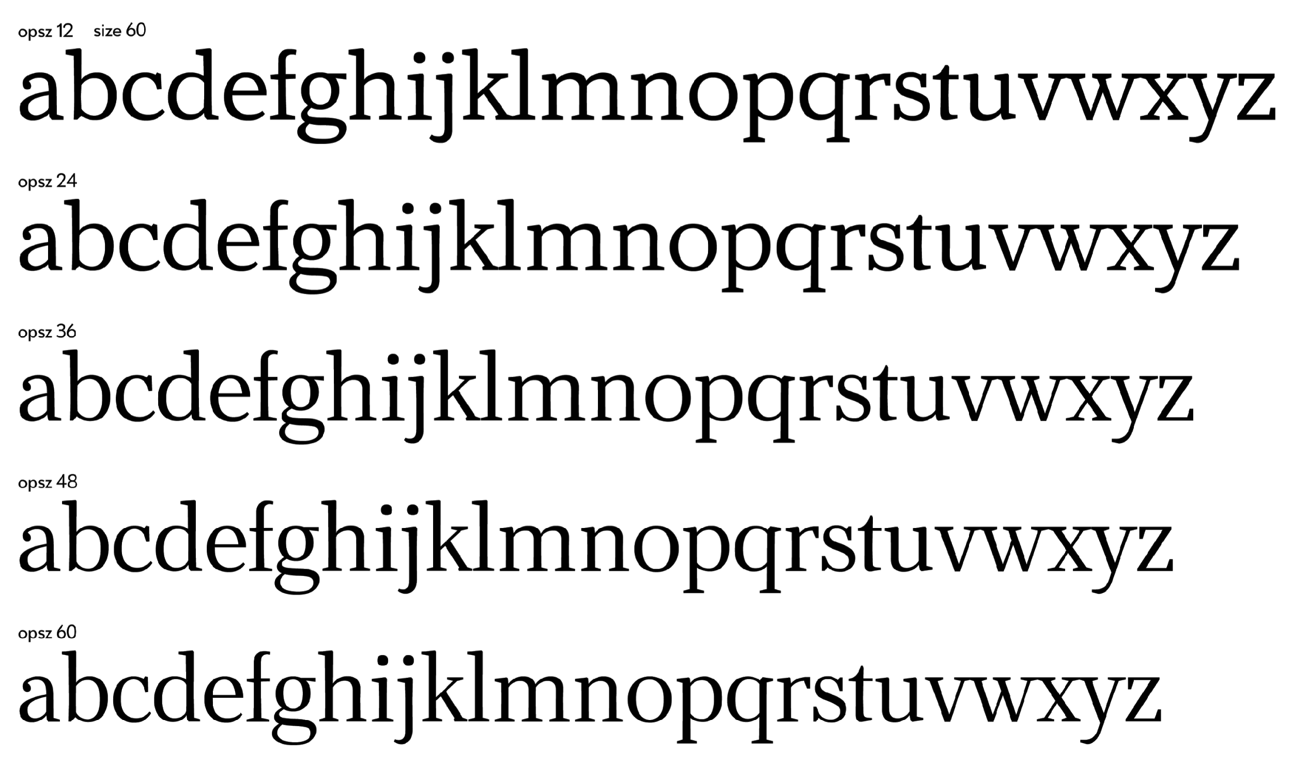
github.com/TypeNetwork/Amstelvar
Notes:
And here you see some interpolations

Slide 55
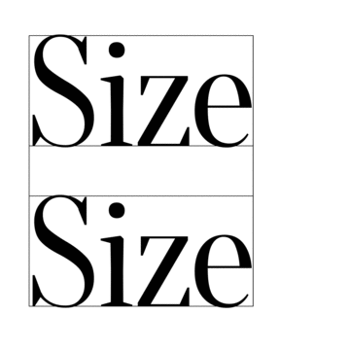
Illustration by Petr van Blokland, made with Drawbot
Notes:
This is a GIF to show the 2 ways of looking at the variation in context, by Petr van Blokland for Font Bureau

Slide 56
“Where can I obtain optical size designs?”
Notes:
.

Slide 57
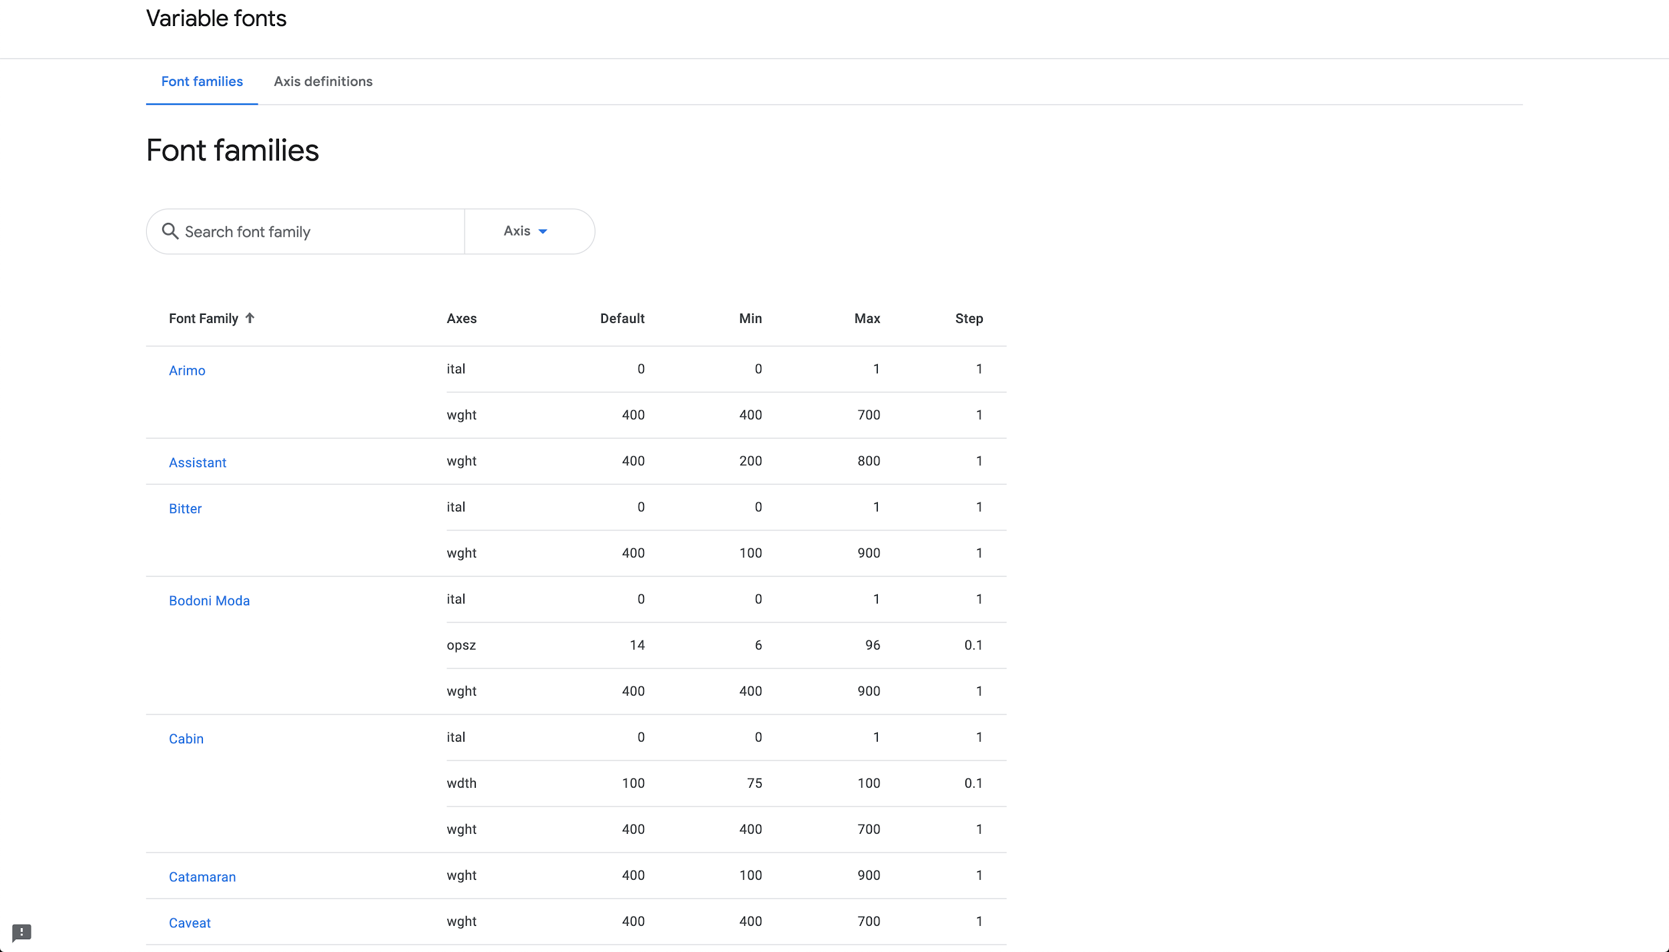
fonts.google.com/variablefonts
Notes:
fonts.google.com/variablefonts (linked to on the about page) lists all the GF VFs

Slide 58
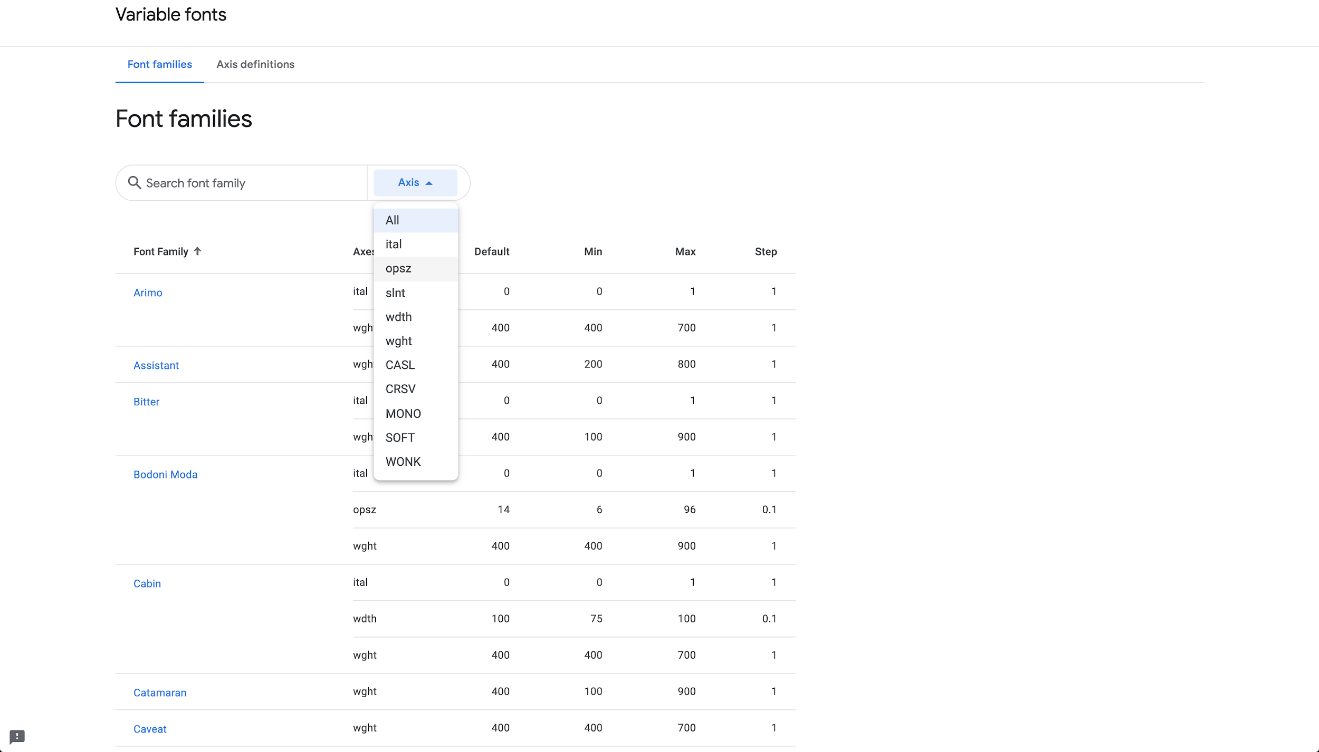
fonts.google.com/variablefonts
Notes:
You can filter for specific axes, like opsz

Slide 59
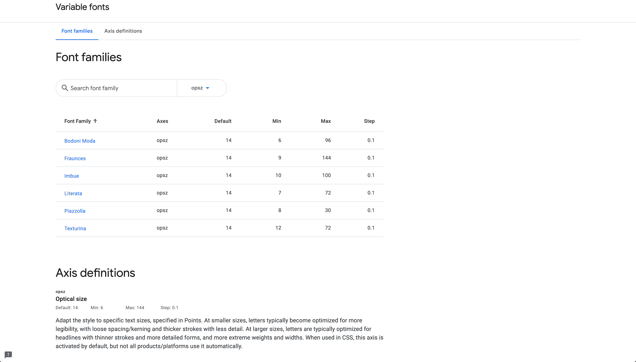
fonts.google.com/variablefonts
Notes:
These are the current opsz options

Slide 60
fonts.google.com/variablefonts
Notes:
Let’s look more closely at 1, Literata

Slide 61
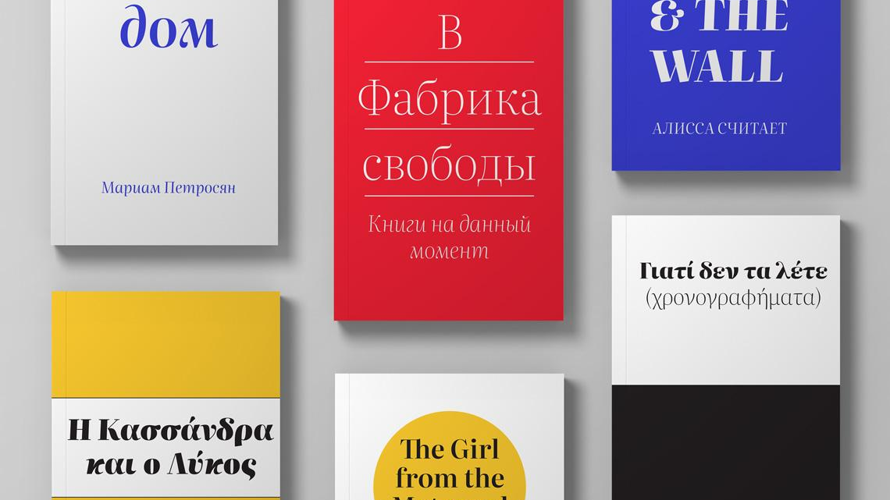
type-together.com/literata-3
Notes:
This is a family by Type Together, a top international foundry, commissioned by me for the Play Books eReader App team, with art direction from TT’s principle designer Vik Burian, and a lot of feedback from Christian Robertson and Raph Levien. It supports Latin, Greek and Cyrillic, with a range of weights and optical sizes.
(Images from https://www.type-together.com/literata-3)

Slide 62
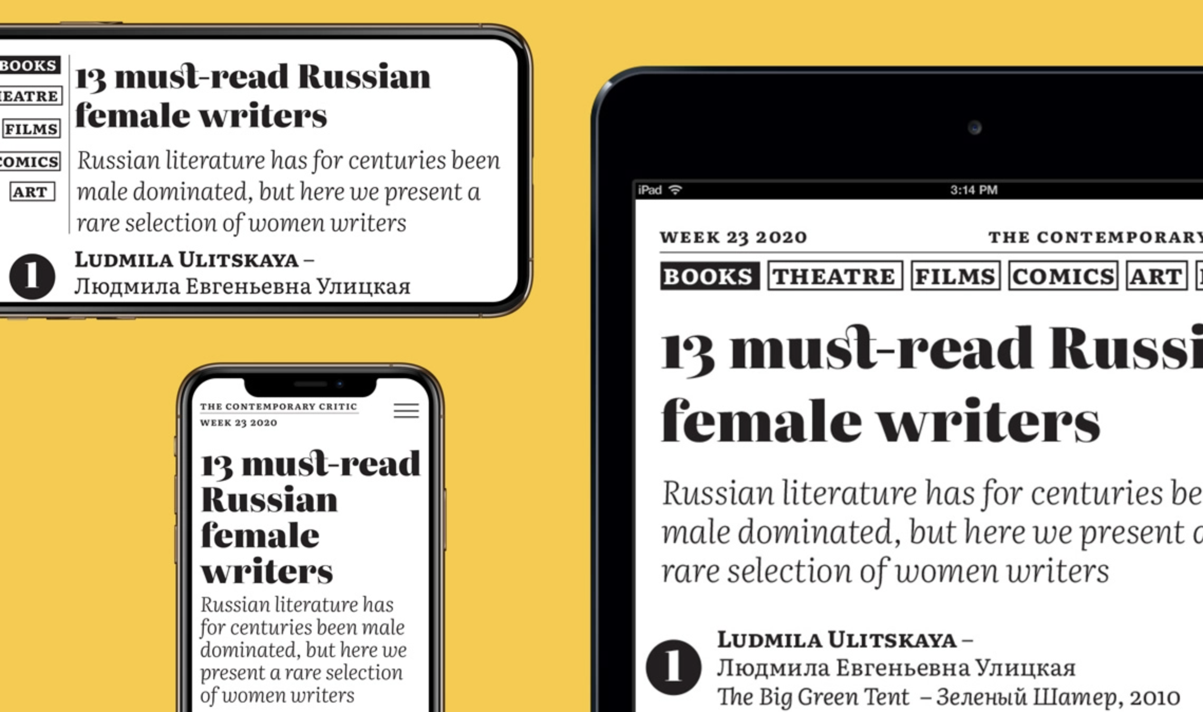
type-together.com/literata-3
Notes:
It was specifically designed for reading books on screens - mobiles and tablets.
(Images from https://www.type-together.com/literata-3)

Slide 63
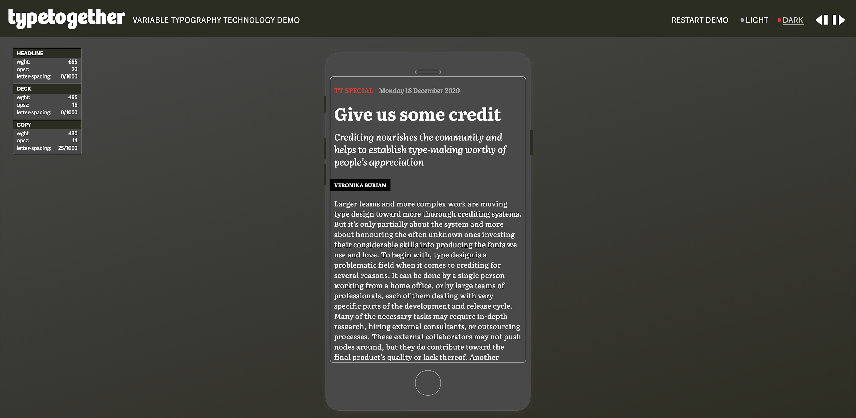
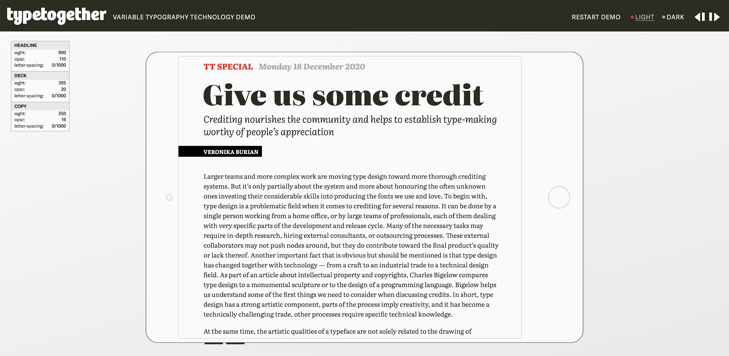
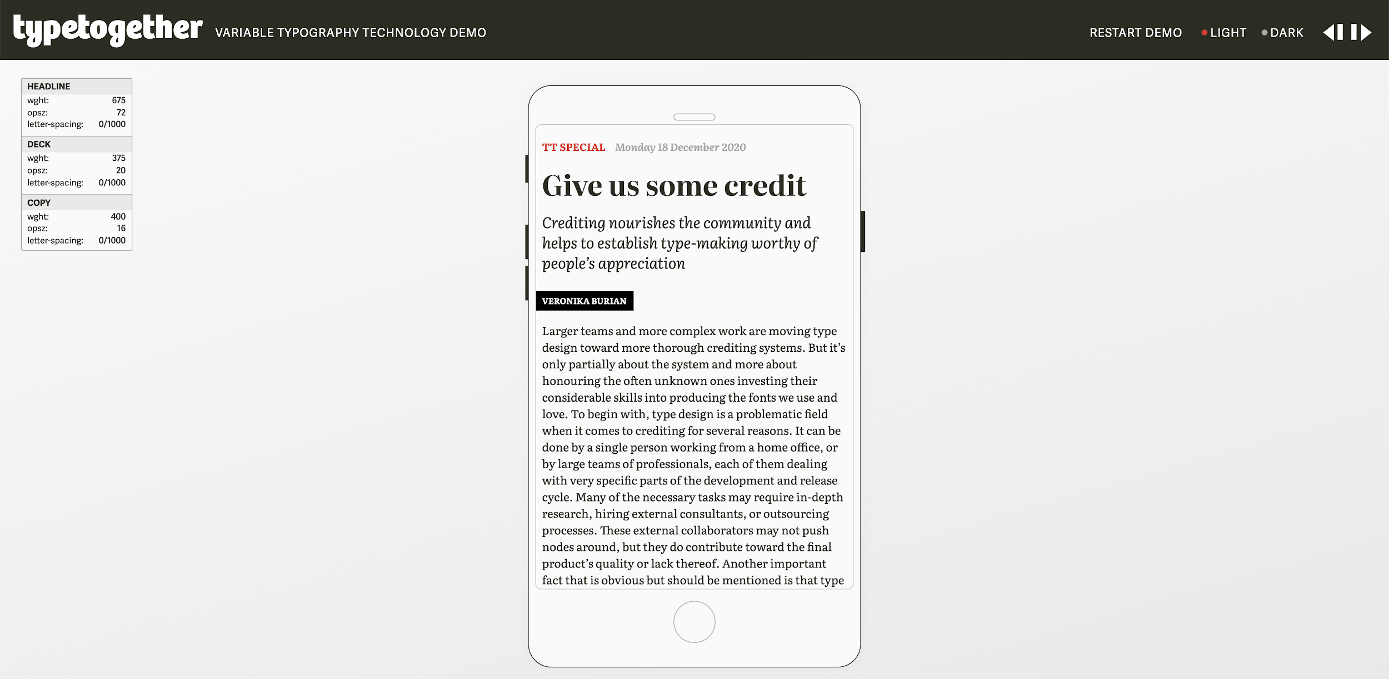
type-together.com/demos/literata
Notes:
There’s a wonderful interactive demo of it at type-together.com/demos/literata

Slide 64
type-together.com/demos/literata
Notes:
And it has a dark theme preview. If I toggle back and forth between this and the last slide, you can see the weight axis is adjusted in different ways at different sizes, also the ‘tracking’ or ‘letter-spacing’ CSS property.
And you can also see the way that cause line breaking to change.

Slide 65
type-together.com/demos/literata
Notes:
Here’s the mobile view, with similar adjustments.

Slide 66
type-together.com/demos/literata

Slide 67
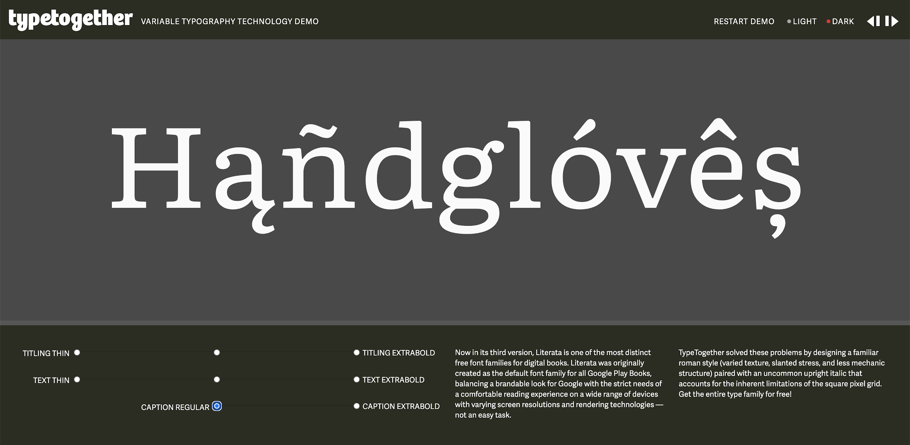
type-together.com/demos/literata
Notes:
At the end of the demo app there’s this page to zip around the named styles.
Here you see in a way the ‘upside down pyramid’ again, in the reduced range on the 3rd row of radio buttons

Slide 68
“Where can I play with optical size designs?”
Notes:
.

Slide 69
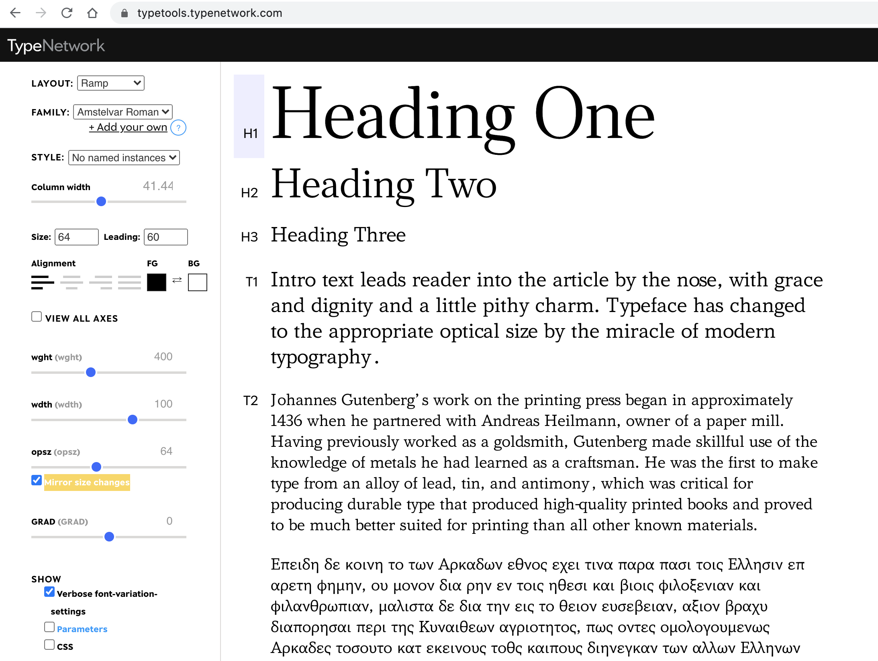
typetools.typenetwork.com
Notes:
At typetools.typenetwork.com!
This app was developed by David Berlow and the Font Bureau team to develop their fonts, and provides quite fine typographic control in a browser.
Just drag and drop any variable font onto the page.

Slide 70
“How can I use optical size designs?”
Notes:
.

Slide 71
typetools.typenetwork.com
Notes:
If you scroll down, you’ll see a really key thing about optical size,
which in this UI is shown as the “mirror size changes” toggle
This is very important for optical size.

Slide 72
Auto approximation
font-optical-sizing: auto
Notes:
It is the key to ‘finesse’ - automation.
Optical size is automated on the web, out of the box, by default, for any font that has an opsz axis.

Slide 73
Notes:
And this is not a very novel concept in the TeX developer community!
Here’s a great email from Hans Hagen in 2013!
Whatever TeX engine/package you use, if it uses variable fonts,
you should find out if it supports auto-setting the opsz axis.

Slide 74
Why are these changes made?
2 confounding ideas
Notes:
Now, I want to take a step back and talk a little less practically, about some theoretical ideas about optical size. I want to provide some ideas about reasoning about why these changes are made for size specific optimizations.
I think this is interesting, because its possible to select a different optical size than the automatically selected one,
so as a user, its good to understand why the defaults are the way they are.
There are 2 ideas I want to present, which are in some ways rather astonishing, or at least, somewhat confounding.

Slide 75
1. Human Perception Physiology + Neurology
The Doors of Perception
Notes:
The first topic is perception itself.
Readability is determined by the limits of human physical perception,
a combination of biology and brain mechanics.
Your mind is hallucinating your perception of reality. It is lying to you.

Slide 76
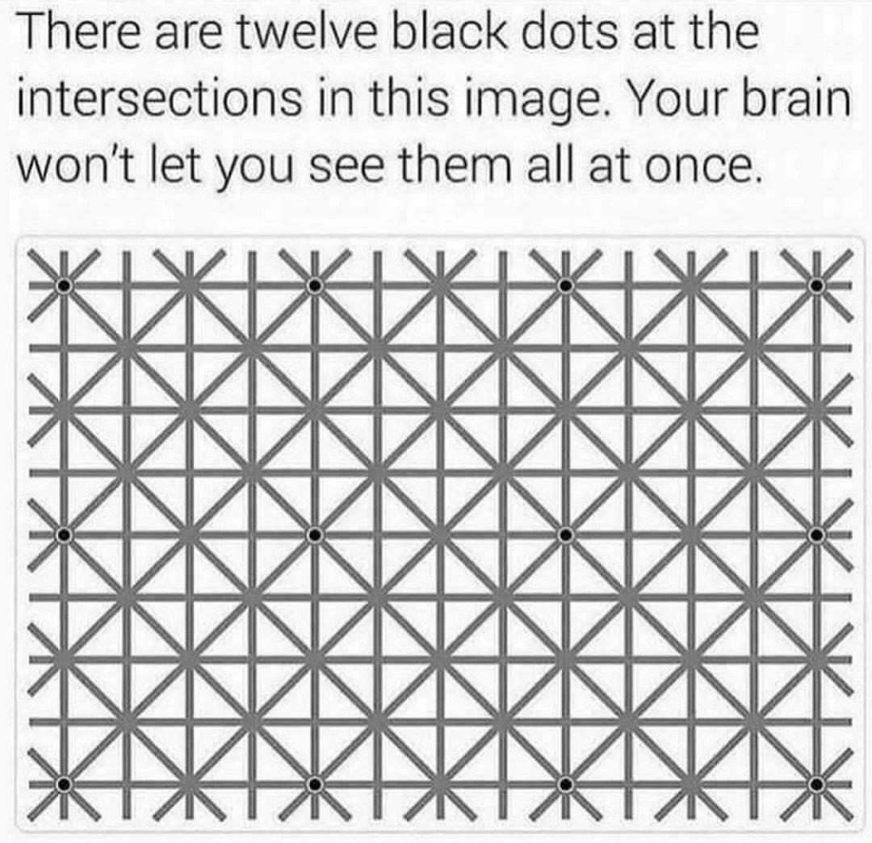
twitter.com/TeslaPhx/status/1373436726727745537
Notes:
It can make things appear when they are not there.
https://twitter.com/TeslaPhx/status/1373436726727745537

Slide 77
twitter.com/TeslaPhx/status/1373436726727745537
Notes:
It can make things appear when they are not there.
https://twitter.com/TeslaPhx/status/1373436726727745537

Slide 78
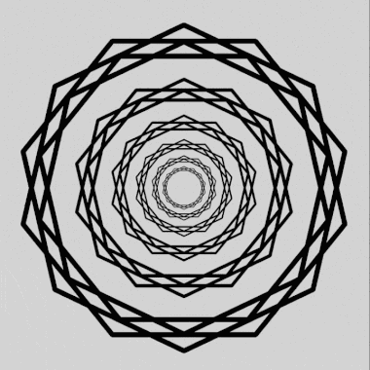
iflscience.com/brain/brand-new-type-of-optical-illusion-tricks-the-brain-into-seeing-shimmering-rays
Notes:
Another example.
https://www.iflscience.com/brain/brand-new-type-of-optical-illusion-tricks-the-brain-into-seeing-shimmering-rays

Slide 79
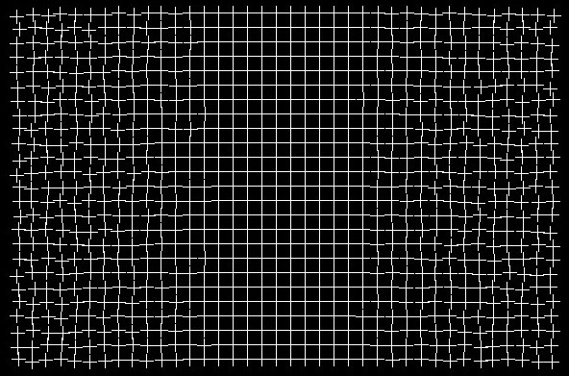
kottke.org/21/04/healing-grid-optical-illusion
Notes:
It can also make things disappear.
www.kottke.org/21/04/healing-grid-optical-illusion

Slide 80
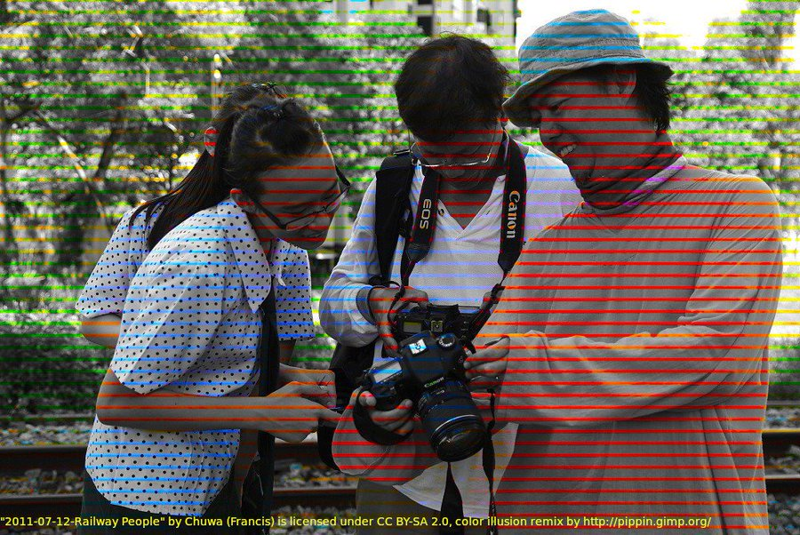
twitter.com/SteveStuWill/status/1380203791191007233/photo/1
Notes:
Color can be made to appear.
https://twitter.com/SteveStuWill/status/1380203791191007233/photo/1

Slide 81
twitter.com/SteveStuWill/status/1380203791191007233/photo/1
Notes:
Color can be made to appear.
https://twitter.com/SteveStuWill/status/1380203791191007233/photo/1

Slide 82
neurosciencenews.com/brightness-optical-illusion-1
Notes:
And in greyscale, brightness is relative.
https://neurosciencenews.com/brightness-optical-illusion-1

Slide 83
neurosciencenews.com/brightness-optical-illusion-1
Notes:
And in greyscale, brightness is relative.
https://neurosciencenews.com/brightness-optical-illusion-1

Slide 84
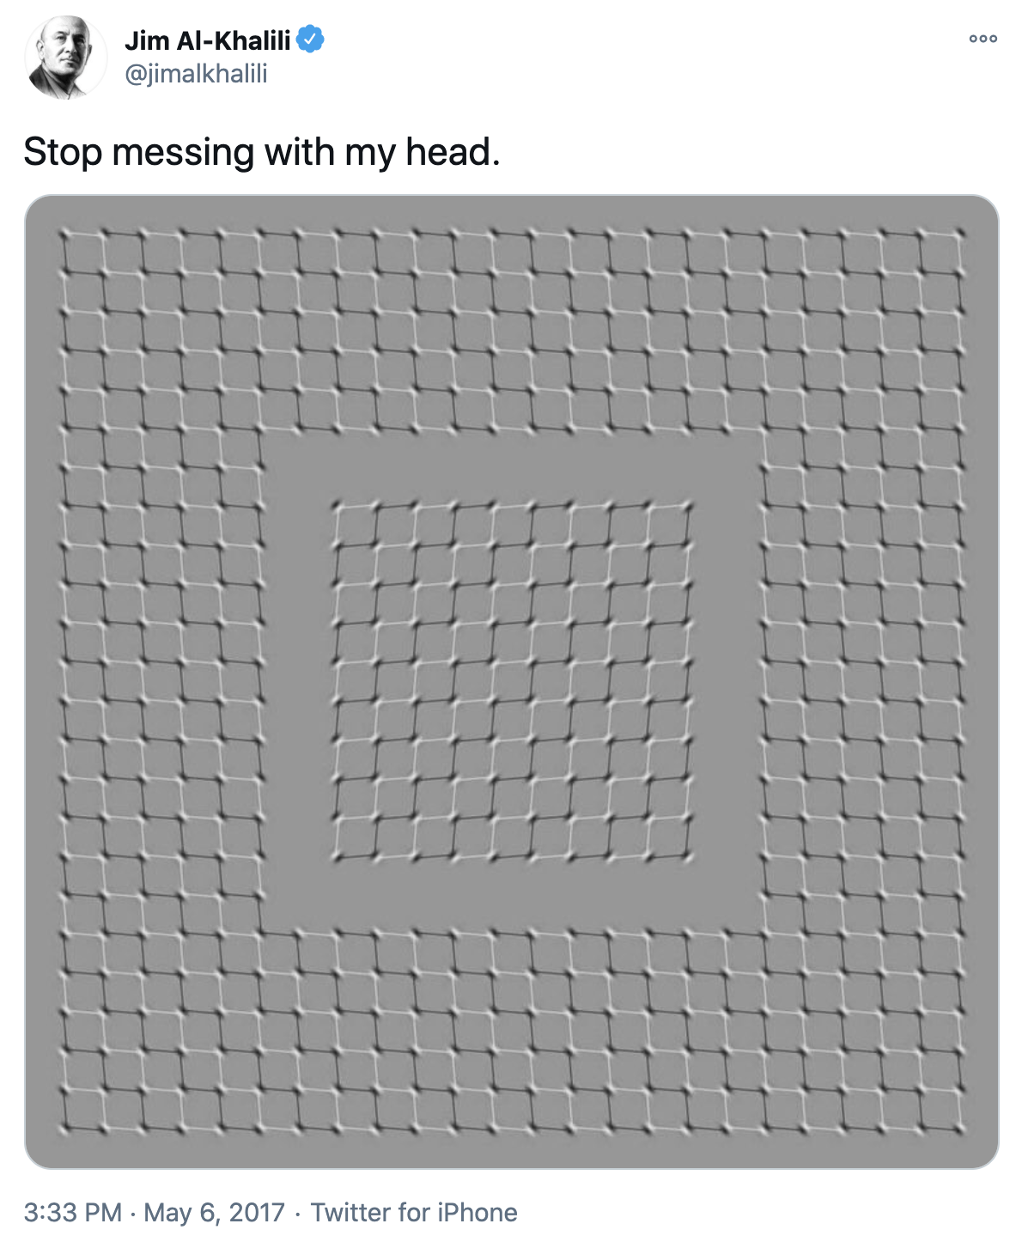
twitter.com/jimalkhalili/status/860940648492478472
Notes:
You can see movement when its not there. Look at the 4 corners, and you see a shimmering.
But this is a static image - not a GIF.
This shows how our perception has something built-in
for processing patterns of black and white,
in our peripheral vision.
https://twitter.com/jimalkhalili/status/860940648492478472

Slide 85
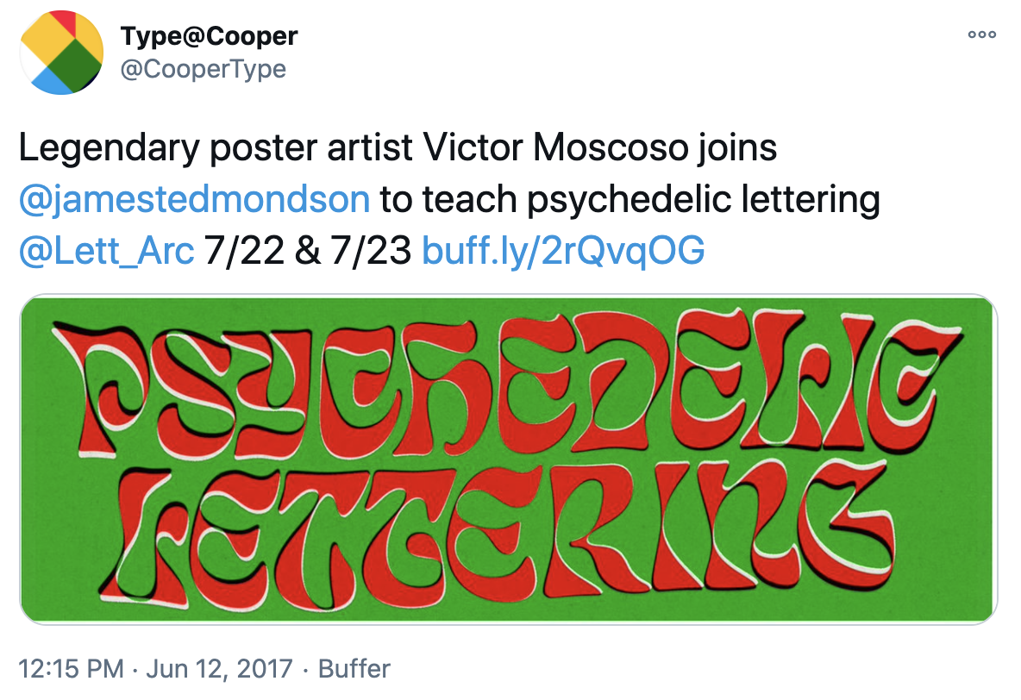
twitter.com/CooperType/status/874299038920781824
Notes:
And this optical effect has been utilized in type design explicitly, such as in this lettering piece by Victor Moscoso.
https://twitter.com/CooperType/status/874299038920781824

Slide 86
Same lines look different lengths. researchgate.net/publication/42834022_Application_of_Riesz_transforms_to_the_isotropic_AM-PM_decomposition_of_geometrical-optical_illusion_images
Notes:
These illusions are created to exaggerate these effects.
– researchgate.net/publication/42834022_Application_of_Riesz_transforms_to_the_isotropic_AM-PM_decomposition_of_geometrical-optical_illusion_images

Slide 87
Same size shapes look different sizes. Straight lines look crooked. researchgate.net/publication/42834022_Application_of_Riesz_transforms_to_the_isotropic_AM-PM_decomposition_of_geometrical-optical_illusion_images
Notes:
Same size shapes look different sizes. Straight lines look crooked.
researchgate.net/publication/42834022_Application_of_Riesz_transforms_to_the_isotropic_AM-PM_decomposition_of_geometrical-optical_illusion_images

Slide 88
Straight lines don't even look straight. researchgate.net/publication/42834022_Application_of_Riesz_transforms_to_the_isotropic_AM-PM_decomposition_of_geometrical-optical_illusion_images
Notes:
Okay, the preceding examples are a little gimmicky.
The point is to remind you, well, who should you believe, me or your lying eyes? :)
But there are some optical effects that are highly relevant to the perception of regular B&W type forms.
Straight lines don't even look straight.
You can cover up parts of the screen (or hold up a straight edged piece of paper) to un-trick your mind into seeing the straight lines :)
researchgate.net/publication/42834022_Application_of_Riesz_transforms_to_the_isotropic_AM-PM_decomposition_of_geometrical-optical_illusion_images

Slide 89
2. What is ‘size’?
Points and arc minutes
Notes:
Now, the other topic, adjacent to the first, is size.
While in everyday life we use meters and centimeters, or feet and inches, in typography the classic unit for size is points.
However, a novel way of measuring size in physics is the unit of “arc minutes.”

Slide 90
Notes:
Viewing distance is very rarely fixed.
– A Clockwork Orange

Slide 91
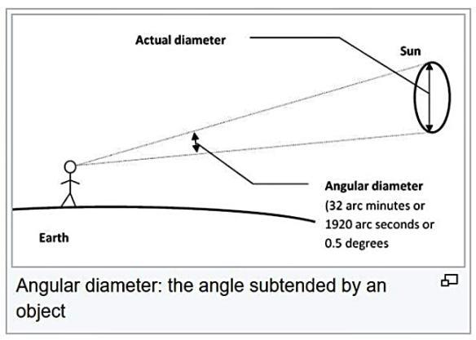
tonylouis.wordpress.com/2017/12/29/angular-diameter-sect-and-the-aries-ingress
Notes:
And this means things as you do move closer or farther away from a thing, because the light landing on your eye’s retina changes, the apparent size changes. We can normalize this size difference, referring to size in a constant way, with the concept of the “angular diameter”, which uses units of “arc minutes”.
– tonylouis.wordpress.com/2017/12/29/angular-diameter-sect-and-the-aries-ingress

Slide 92
tiro.com/John/SameDifference2-DECK.pdf
Notes:
Again, the big concept is that shapes around a shape will dramatically change the perception of that shape.
So, repeated bands of black and white have different effects when the bands are different sizes. You can see this along the bottom of this image, where the contrast is highest.
You should see a kind of “hump” in the left-middle of the image. This shows a kind of ‘sweet spot’ in your neurology for that range of contrast and spatial frequency; to the left, the lines are too far apart and blur together, and to the right they are too close to each other and also blue together.
What is wild is that, if you scale the image, or get up and walk away from the computer, you’ll see the “shape” of the hump change, shifting leftwards! :)
This image is from a presentation by famous type designer John Hudson, and his speaker notes on this explain what is happening well:
” The phenomenon I want to discuss is spatial frequency, and how we perceive it, and I’ll try to do this with as little scientific terminology as possible.
What we’re looking at in this image is a progression, from right to left, in spatial frequency from high to low. High spatial frequency means more changes between dark and light bands, in the same distance, compared to fewer changes between dark and light bands at low spatial frequency.
There is also a progression from bottom to top, between high contrast at the bottom to low contrast at the top.
There are a couple of interesting things to note about this image. One is that as the contrast of the high spatial frequency bands decreases it becomes harder to see them, so the upper right corner of the image appears to be just a uniform grey area.
In the middle of the image, though, we can perceive the bands further up, which indicates that we are more sensitive to particular ranges of spatial frequency.
The other interesting thing is that this image looks different depending where you are sitting in the room.
The further back you are, the more difficult it will be for you to distinguish the high frequency bands as the contrast decreases, so the larger that uniform grey area in the upper right will appear.
If we were able to get far enough back, almost the whole rectangle would appear grey. “
– tiro.com/John/SameDifference2-DECK.pdf

Slide 93
The state of the art, 1900 & 2020 w3.org/TR/css-fonts-4/#font-optical-sizing-def
Notes:
So, finally we look at some “optical size” styles, for 2 typeface designs, made 120 years apart.
Here we see at the top the “Century Expanded” typeface family, published in 1900 by the American Type Founders company, with the image prepared by Nick Sherman (who runs v-fonts.com and apprenticed under David Berlow) and published in the CSS4 spec for the “font-optical-sizing” property (w3.org/TR/css-fonts-4/#font-optical-sizing-def)
And below it, the same kind of image showing Roboto Flex made today (from github.com/typenetwork/Roboto-Flex/docs/Roboto%20Flex%20Animations/roboto-animations.html)
(Note the images are progressing in opposite directions)
In both cases, the smaller size design is much wider than the large size design, its proportionally taller too, and the “pen strokes” of the letter are thicker.
These are all changes to the spatial frequency of the typeface, which, per the previous slide, keeps text in the “sweet spot” for clear visual perception.

Slide 94
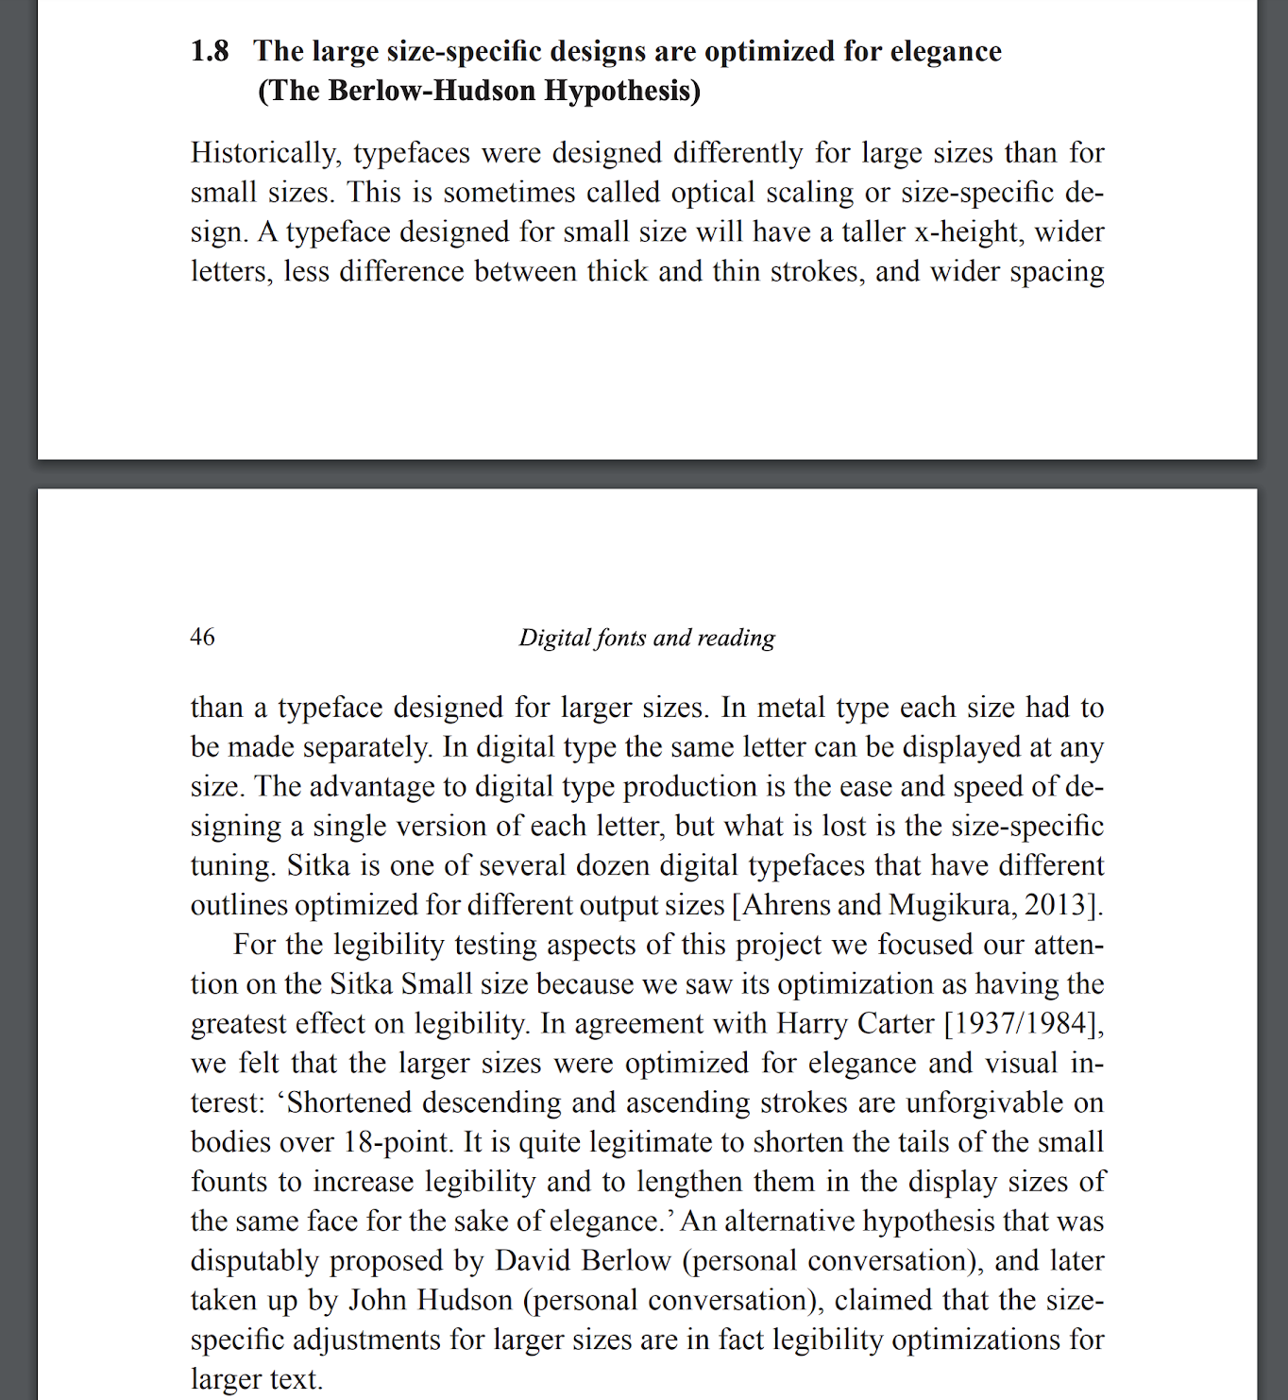
researchgate.net/publication/309754147_Sitka_A_collaboration_between_type_design_and_science
Notes:
Ultimately, David Berlow’s idea is that these changes to BOTH small and large size designs, are for improved legibility and readability.
https://www.researchgate.net/publication/309754147_Sitka_A_collaboration_between_type_design_and_science

Slide 95
researchgate.net/publication/309754147_Sitka_A_collaboration_between_type_design_and_science
Notes:
I want to talk about both the improvement to “large” type, and “small” type.

Slide 96
researchgate.net/publication/309754147_Sitka_A_collaboration_between_type_design_and_science
Notes:
Let’s address large type first, quickly.

Slide 97
Brand Design: Logo anti-homogenization
Optical size for ‘downsizing’
Notes:
Now, let’s look at a practical application of this, to branding.

Slide 98
Notes:
Here’s Google’s logo update in 2015

Slide 99
underconsideration.com/brandnew/archives/new_logo_and_identity_for_intel
Notes:
And Intel’s logo update in 2020.
https://twitter.com/ucllc/status/1301536181931380743?s=19 https://www.underconsideration.com/brandnew/archives/new_logo_and_identity_for_intel.php

Slide 100
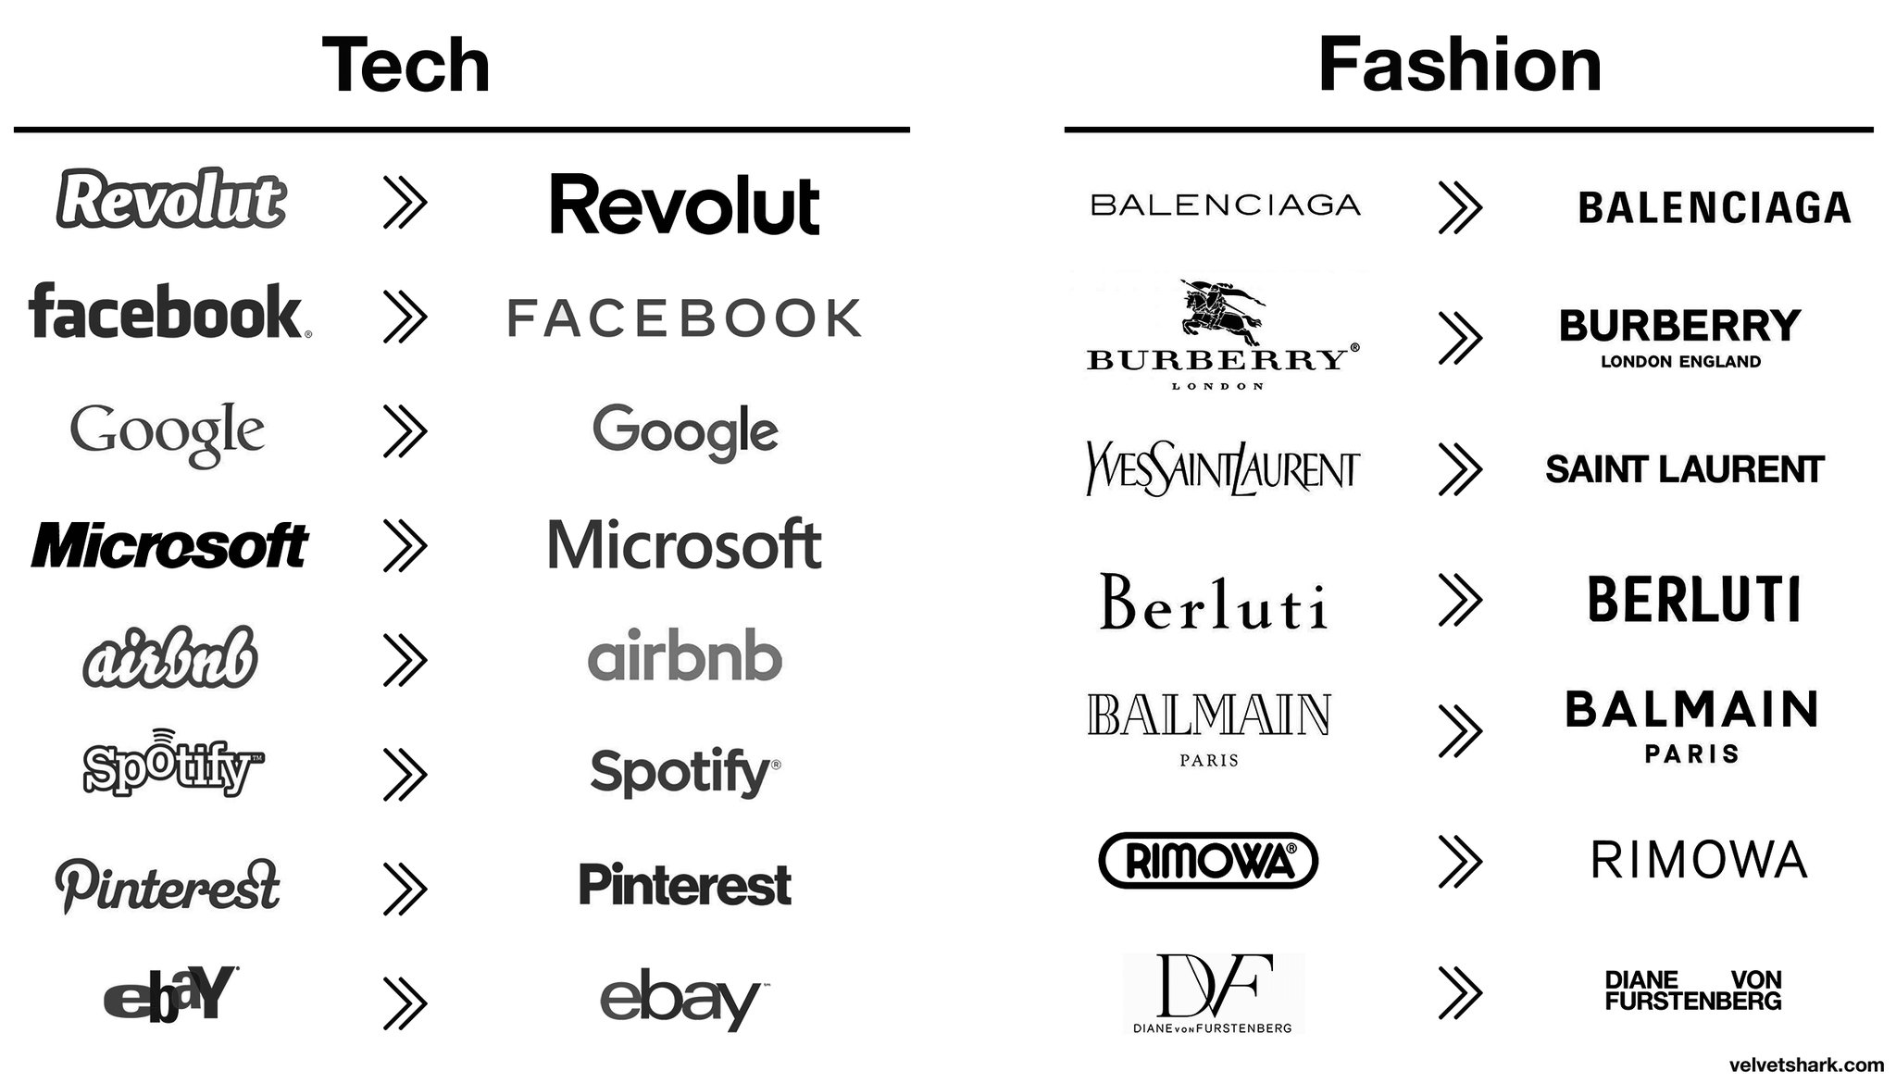
twitter.com/rajandelman/status/1352982025351913473
Notes:
Lots of brands have done this, in tech, and in fashion.
Why? https://twitter.com/rajandelman/status/1352982025351913473

Slide 101
variablefonts.typenetwork.com
Notes:
David Berlow has offered a hypothetical example on his “VF textbook” website, variablefonts.typenetwork.com

Slide 102
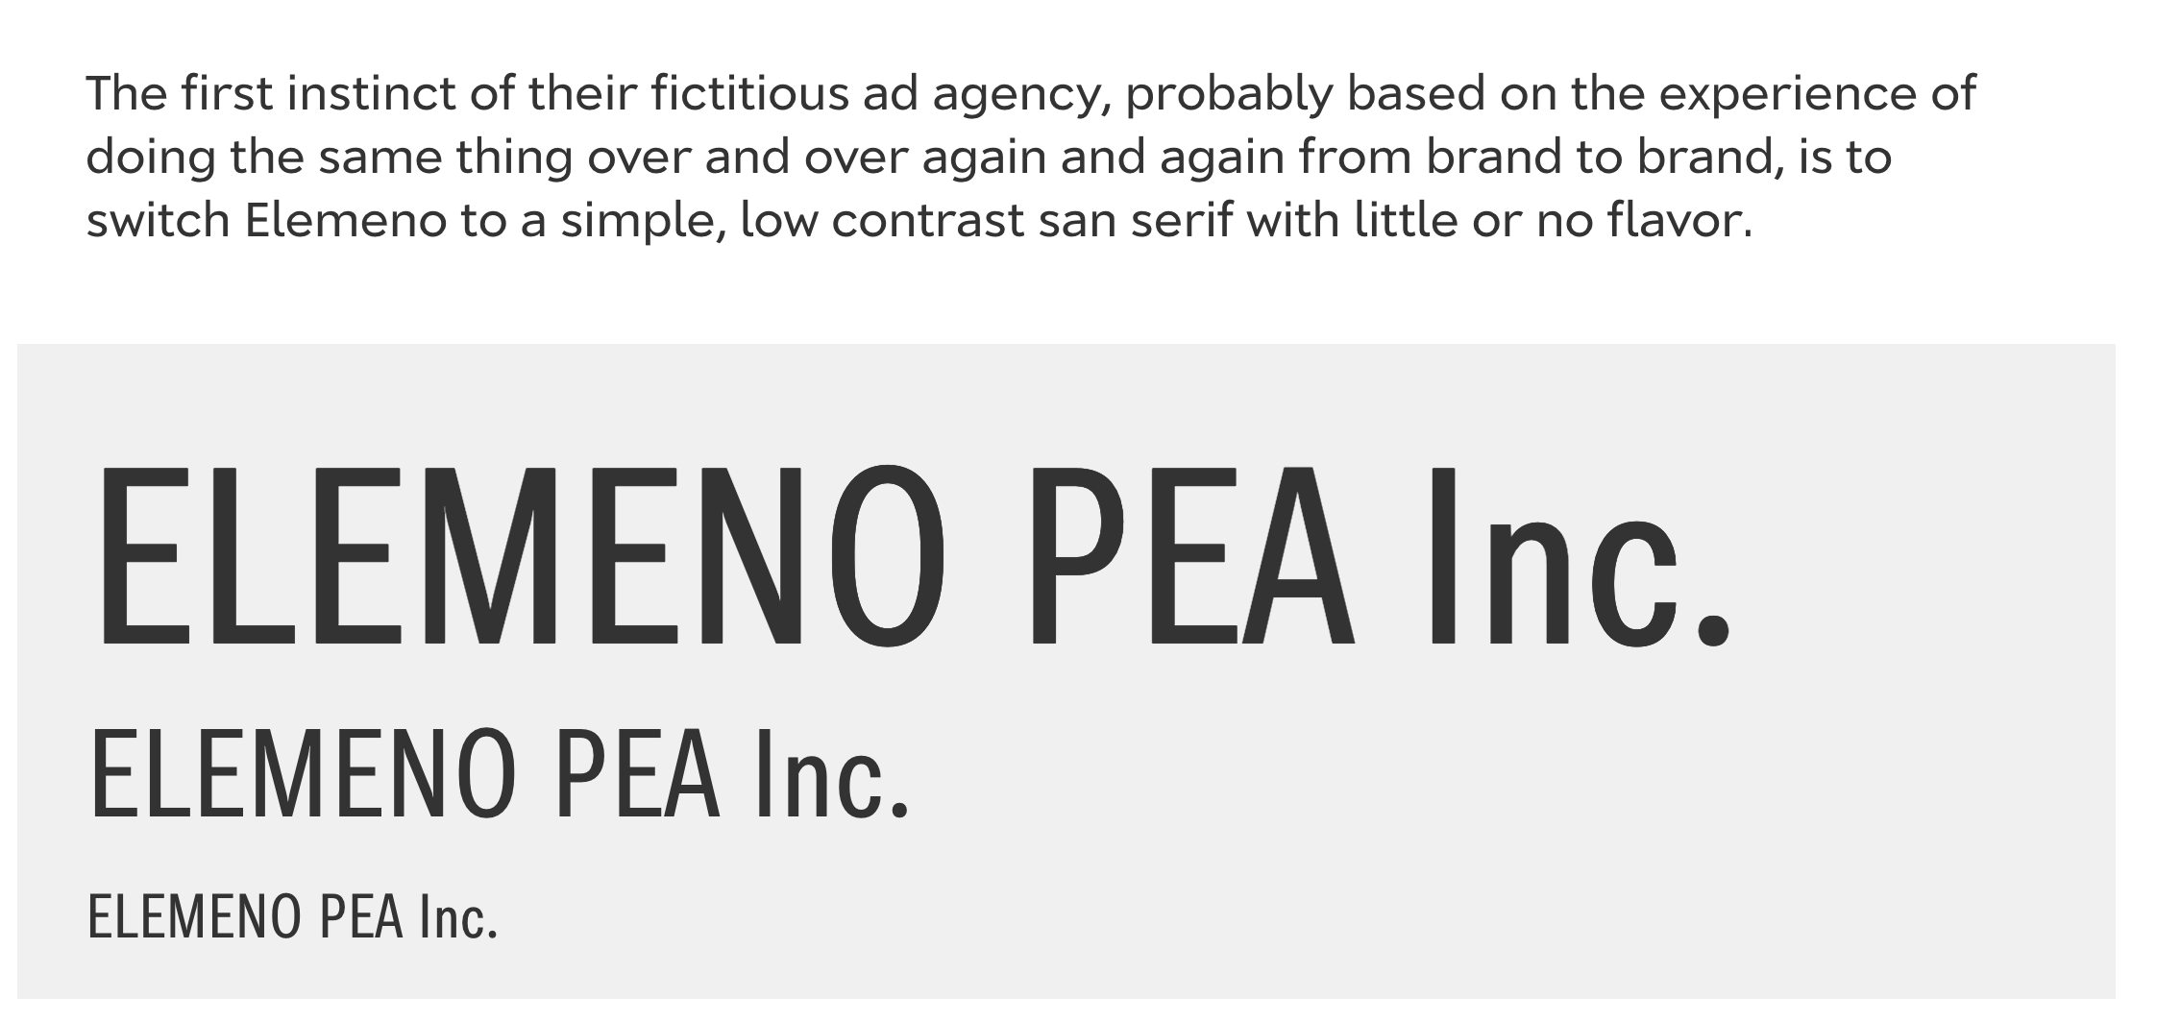
variablefonts.typenetwork.com
Notes:
These ‘bland’ designs perform very well at all (small) sizes.

Slide 103
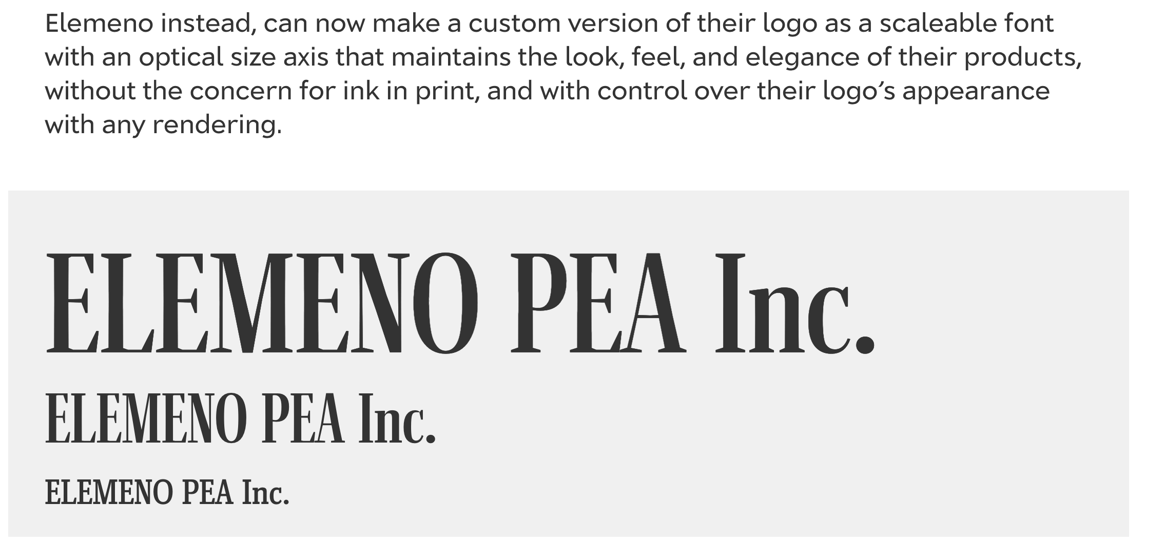
variablefonts.typenetwork.com
Notes:
Optical size can make them ‘resilient’.

Slide 104
variablefonts.typenetwork.com
Notes:
Here’s a comparison, before.
Pay attention to the smallest 3rd line.

Slide 105
variablefonts.typenetwork.com
Notes:
And after.

Slide 106
Reading fluency
Optical size for better comprehension, retention, and speed
Notes:
So that’s what optical size can do for branding typography in logos. Large type.
Turning to small type, the changes at small sizes also matter for body copy, and this is probably of more interest to TeXXies :)
That is all about reading *fluency*, which has 3 components, comprehension, retention, and speed.
A provocative idea I learned from Dr Bonnie Shaver Troupe is that SPEED is something typography can influence to improve comprehension and retention.

Slide 107
Stem rhythm
Notes:
Readability is determined by the limits of human physical perception,
a combination of biology and brain mechanics.

Slide 108
Stem rhythm
minimum
Notes:
The word “minimum” shows this ‘fencepost effect.’

Slide 109
Stem rhythm Saccades
minimum
Notes:
As we read across a line, our eye jumps in a pattern of ‘saccades’.

Slide 110
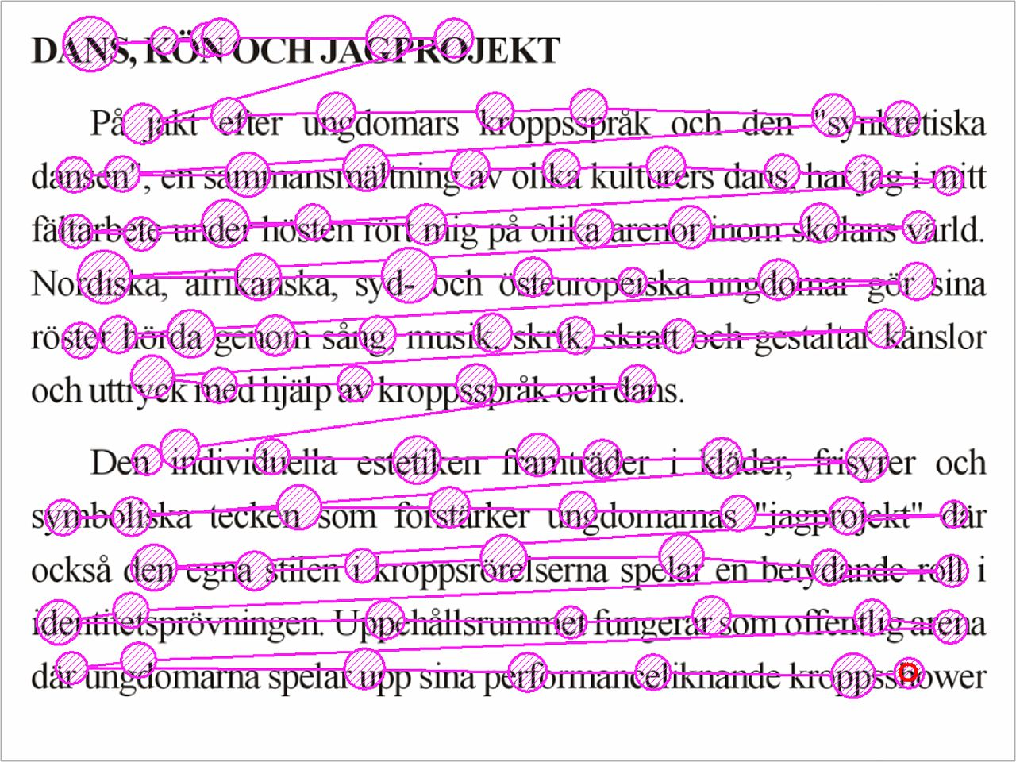
[diagram of saccades]
en.wikipedia.org/wiki/Eye_tracking
Notes:
This is what saccades look like when measured with eye tracking technology.
https://en.wikipedia.org/wiki/Eye_tracking
https://upload.wikimedia.org/wikipedia/commons/thumb/e/ef/Reading_Fixations_Saccades.jpg/1280px-Reading_Fixations_Saccades.jpg

Slide 111
Notes:
This means we can read text even if the letter order
is jumbled up inside each word.
And why I at least personally often have a hard trouble spotting typos.
http://www.foxnews.com/story/2009/03/31/if-can-raed-tihs-msut-be-raelly-smrat.html

Slide 112
quora.com/What-is-the-most-interesting-font-ever-made/answer/Martin-Silvertant
Notes:
Even if the shapes are flipped around in various ways,
they are still astonishingly comfortable to read.
https://www.quora.com/What-is-the-most-interesting-font-ever-made/answer/Martin-Silvertant

Slide 113
lexend.com
Notes:
Bonnie has led the lexend.com project for many years to explore and validate this hypothesis.
She worked with Thomas Jockin to make the lexend variable fonts,
aiming to improve reading by adjusting what we call “spacing”, inter letter spacing, the space between the letters; and also increasing the space inside the letters.

Slide 114
lexend.com
Notes:
Here’s a little of that adjusted.

Slide 115
lexend.com
Notes:
And here’s a lot more. This might be worse for a very fluent reader of normal type,
but much better than normal for a slower reader.
The hypothesis is that the wider width and more inter letter spacing slows down reading,
syncing the physiological and neurological processes.
Hopefully you can connect what you have here, with the spatial frequency graph I showed a while ago.
And variable fonts technology is ideal for this, because it allows you to closely finesse how much of that you want.

Slide 116
Product & Page Design: A better type ramp
The spine of a design system, and ‘upsizing’ with Roboto Flex
Notes:
OK, so, Lexend is a special case. How can optical size be more typically useful in typographic design today?
There’s broadly 2 categories of user experience, in terms of brand experience, and in terms of product experience.
Do you like how it works? And do you like who its from?
All organizations publish information across a range of media - paper, web, app, video - and a “design system” is a way of making them more coherent.
And the “spine” of a design system is the typography.
Design system typography is usually specified with a “type ramp,” a kind of “master plan” for how to style different kinds of texts in semantic categories; and this means, at different sizes.
The progression of sizes doesn’t happen linearly, and there are more different kinds of small texts, so this creates a “ramp” of many smaller size styles and a few large ones, ramping up.

Slide 117
Notes:
Here’s the classic Material Design type tamp, using Roboto.
Note how the “Light” (300) weight style is used for the 2 largest sizes.
You can see in the 3rd largest size that the Regular is used, and it seems bolder compared to the 2nd, but less so to the 1st.

Slide 118
Notes:
here’s the same ramp but using Roboto Flex with ‘optical size auto’ turned on, designed by David Berlow at Font Bureau.
Roboto Flex is a project to take the features and learnings from the Amstelvar project into the Roboto UI typeface for Google’s Material Design.

Slide 119
Notes:
Together you see the difference

Slide 120
Feeling comfortable? No? Here the 32pt design is mis-applied to the text sizes.
Notes:
Here we see Roboto Flex’s 32 pt design, mis-applied.

Slide 121
Here the 14 pt design is mis-applied to the display sizes. The H1 is now much longer, and even seems to be bolder.
Notes:
And, for reference, here is what it looks like when only 1 style, the 14 pt, is used for everything.
The headline also apparently becomes bolder, even though it is the exact same style, because while proportions are fixed and scaled, the strokes are thicker in absolute terms - and the spatial frequency is different.

Slide 122
To approximately finesse the headline, the Material Typography guidelines use Light (300) weight at H1.
Notes:
Finally, here is how the original Material 1 typography guidelines resolve that issue with approximation - using the Light weight of the 14 pt design.

Slide 123
Here the intended designs are applied. This should feel more comfortable to read, with nothing out of place.
Notes:
And here each size of text has its own unique optical size design applied.
Note, this is 5 styles, and would carry a filesize cost equivalent to 5 fonts - a good range from Light to Bold weights - before variable fonts.
With Variable Fonts, all 5 can be done with the equivalent file-size of 2 fonts.

Slide 124
Notes:
Compare, before

Slide 125
Notes:
And after.

Slide 126
“But that's just regular!”
The ‘Upside Down Pyramid,’ and ‘upsizing’
Notes:
Next, let’s look at how this works beyond just the “regular” style.

Slide 127
Notes:
Here is again an overview of Roboto’s static fonts, released in 2011 - this is all the styles that were made available then. Obviously, many weights are missing from the Condensed width set.
It is subtle, but you can see if you squint that Condensed Bold is heavier than normal width Bold, but not as heavy as Black.
Why is this?

Slide 128
Notes:
If we normalize the weight and width so nothing is missing...

Slide 129
Notes:
We can see that when used at small sizes, not all are useful.

Slide 130
djr.com/roslindale
Notes:
This makes the design space an ‘upside down pyramid’ of weight and width.
A much wider range of styles at the top, which shrinks as size comes down.
DJR has made a nice illustration of this for a proprietary font family, Roslindale, which he has release in stages, a style or two at a time, through his “font of the month club” business model.
https://twitter.com/unitof/status/1245521475773378562?s=19

Slide 131
Notes:
Roboto Flex adds a LOT more styles for use at large sizes

Slide 132
Roboto Flex: Words in styles that reinforce themselves. github.com/typenetwork/roboto-flex
Notes:
These convey a lot of personality!

Slide 133
One Roboto, many moods
Variable font axes enable a variety of looks
Notes:
But instead of veering back off into expressive large size display type,
I want to talk about how this range of style can be truly finessed.
Here you see 2 examples on the right of how that optical size ‘downsizing’
I reviewed in the Regular style can be custom applied to all of those expressive styles.

Slide 134
“How can I make optical size designs?” A ‘Parametric Axes System’ approach
Notes:
.

Slide 135
XTRA
YTRA
space inside and around the glyph in the
x and y direction.
Notes:
These axes have 2 classes, Transparency (XT.. or YT..)

Slide 136
XOPQ
YOPQ
Changes the stroke weight in the
x and y direction.
Notes:
And Opacity (XO.. or YO..)

Slide 137
XTRA
XOPQ
YOPQ
=
YTRA
Ascender
Descender
Uppercase
Lowercase
Parametric axes change
Spaces independently in the
x (horizontal) and y (vertical) directions
Notes:
These axes control the spaces and strokes horizontally and vertically
.

Slide 138
Weight
+
+
+
=
Width
+
+
+
=
Grade
+
=
Blends are created by combining parametric axes
Notes:
And so combining these axes, forms “blended” axes - like weight, width, and optical size.
.

Slide 139
XTRA
XOPQ
YOPQ
Ascender
Descender
Lowercase
Notes:
These axes combined form Optical size

Slide 140
Start with the default

Slide 141
Negative optical size (downsizing)
Notes:
For downsizing, change the opaque and transparent parts like this...

Slide 142
Positive optical size (upsizing)
Notes:
And for upsizing, change them like this...

Slide 143
Inter script
Notes:
Amstelvar axes of wght, wdth. YTLC, YTUC, YTDE.

Slide 144
Parametric axis: YTRA overall
variationsguide.typenetwork.com

Slide 145
Parametric axis: YTLC lowercase
variationsguide.typenetwork.com
Notes:
https://variationsguide.typenetwork.com/#ytlc

Slide 146
Parametric axis: YTUC uppercase
variationsguide.typenetwork.com
Notes:
https://variationsguide.typenetwork.com/#ytuc

Slide 148
bit.do/calibrate-type

Slide 149
“Where can I learn more?”
Notes:
Now, hopefully you are now invested in learning more about optical size :)

Slide 150
Notes:
https://variablefonts.typenetwork.com/

Slide 151
Thank you
@davelab6

Slide 152
fonts.google.com/variablefonts
design.google/library/variable-fonts-are-here-to-stay type-together.com/demos/literata variablefonts.typenetwork.com typetools.typenetwork.com
axis-praxis.org
Notes:
Here are some links to the things I’ve presented today, so far.

